Slide 1
Next-generation Latent Fingermark Detection Using Functionalised Silicon Oxide Nanoparticles
Timothy Lee
PhD Candidate
Western Sydney University, School of Science and Health
Prof. Chris Lennard ¹
Prof. Claude Roux ²
Dr Sébastien Moret ²
Dr Fehmida Kanodarwala ²
Dr Xanthe Spindler ²
Dr Val Spikmans ¹
¹ Western Sydney University, School of Science and Health
² University of Technology Sydney, Centre for Forensic Science
ANZFSS 24th International Symposium – 10 September 2018

Slide 2
Why Silicon Oxide Nanoparticles?
Increasing research interest for latent fingermark detection in the past decade
Small size
  Average diameter of around 70 – 80 nm (via reversed micro-emulsion synthesis)^{[1,2]}
Versatile modifiable surface
  External layer of silanol (Si-OH) and siloxane (Si-O-Si) groups^{[3]}
Extended optical properties
  Potential of using a variety of dye molecules in their inner structure^{[1]}
1. Moret, S., Bécue, A. & Champod, C. 2014, Nanotechnology, vol. 25, no. 42, p. 425502.
2. Moret, S., Bécue, A. & Champod, C. 2016, Forensic Science International, vol. 259, pp. 10-8.
3. Bécue, A. & Cantú, A. 2012, Lee and Gaensslen's Advances in Fingerprint Technology, Third Edition, CRC Press, pp. 307-80.

Slide 3
Previous Research
An insight into the use of silicon oxide nanoparticles (SiO₂ NPs) for latent fingermark detection was published in 2016^{[2]}
A RuBpy-doped CES-functionalised SiO₂ NP reagent was proposed
A set of detection parameters was suggested for application
  A working formulation with the use of the functionalised NPs to detect latent fingermarks
2. Moret, S., Bécue, A. & Champod, C. 2016, Forensic Science International, vol. 259, pp. 10-8.

Slide 4
Research Aims
Research in a Nutshell – TL;DL Version
Design and synthesise a novel SiO₂-based NPs for improved fingermark detection
Optimise and validate the technique for latent fingermark detection
The novel and validated technique will be applicable in standard police laboratories as a user-friendly latent fingermark detection method
Make something new
Make it work
Make it better and actually usable

Slide 5
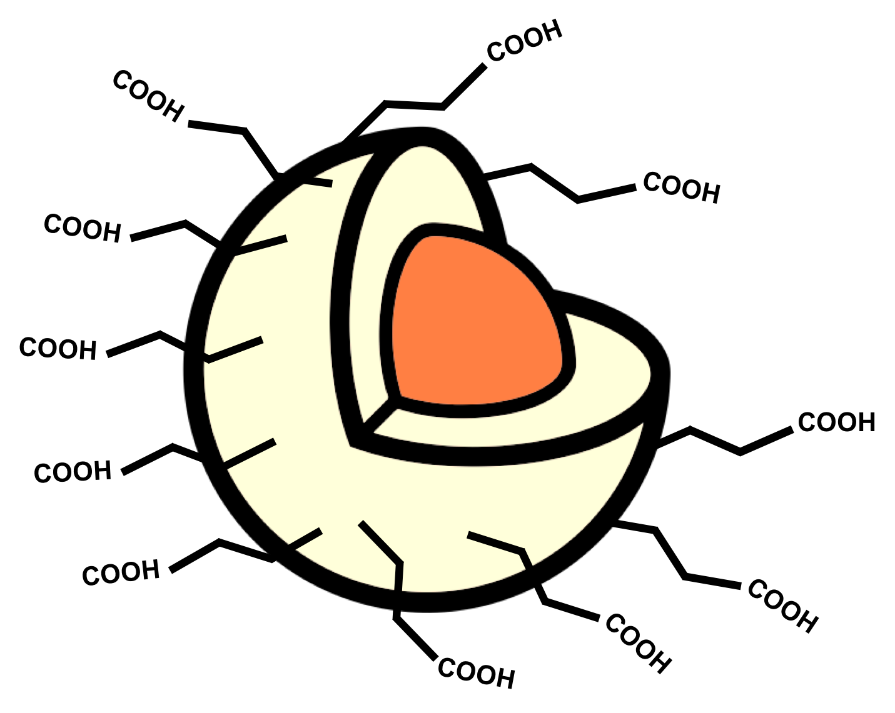






How Does It Work?
Synthesis
72 hours
RuBpy-doped
CES-functionalised SiO₂ NPs
Application
H₂O
5 min
SiO₂ NPs
1 hour
H₂O
5 – 10 min
Visualisation

Slide 6
Concentration of the Nanoparticles
The functionalised NPs are diluted by half in the working formulation^{[2]}
  How much is actually enough to detect latent fingermarks?
  An optimum concentration
Different NP concentrations were compared against the published formulation^{[2]}
  4x, 10x, 20x, 40x, 80x and 200x dilutions of the NPs
2. Moret, S., Bécue, A. & Champod, C. 2016, Forensic Science International, vol. 259, pp. 10-8.

Slide 7
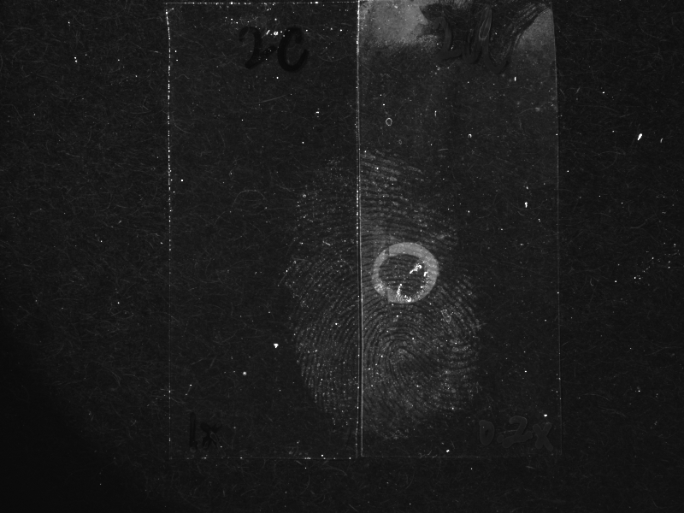
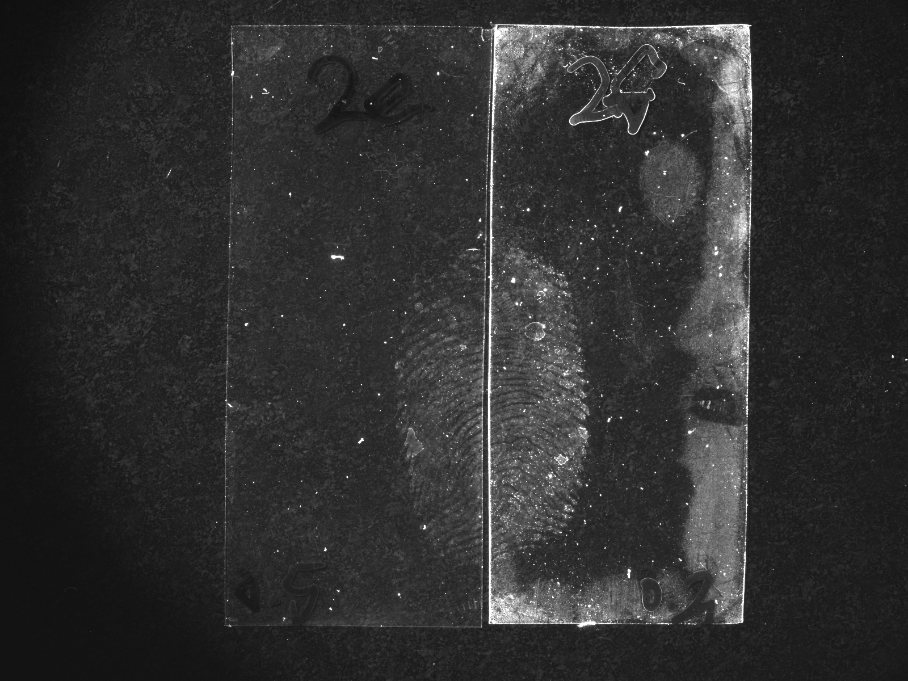
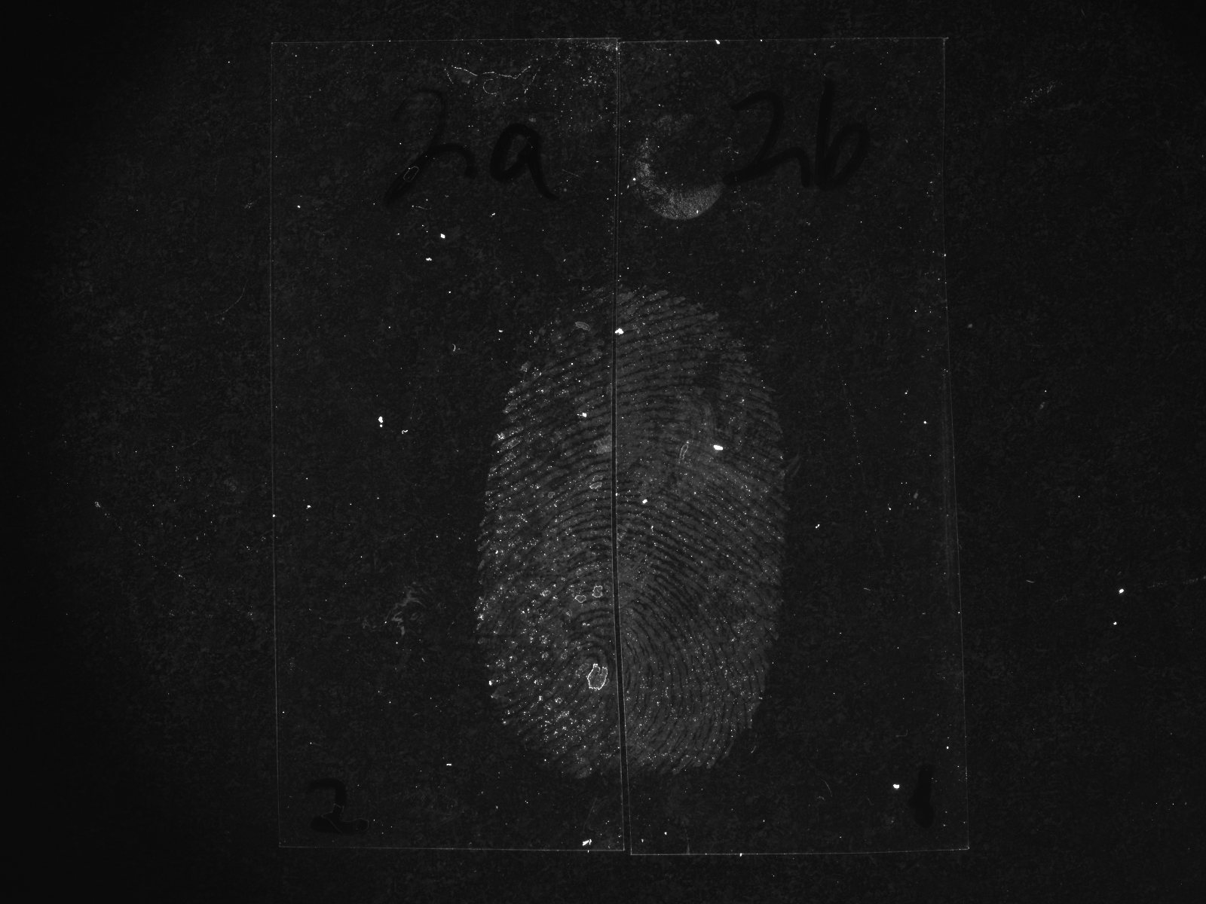
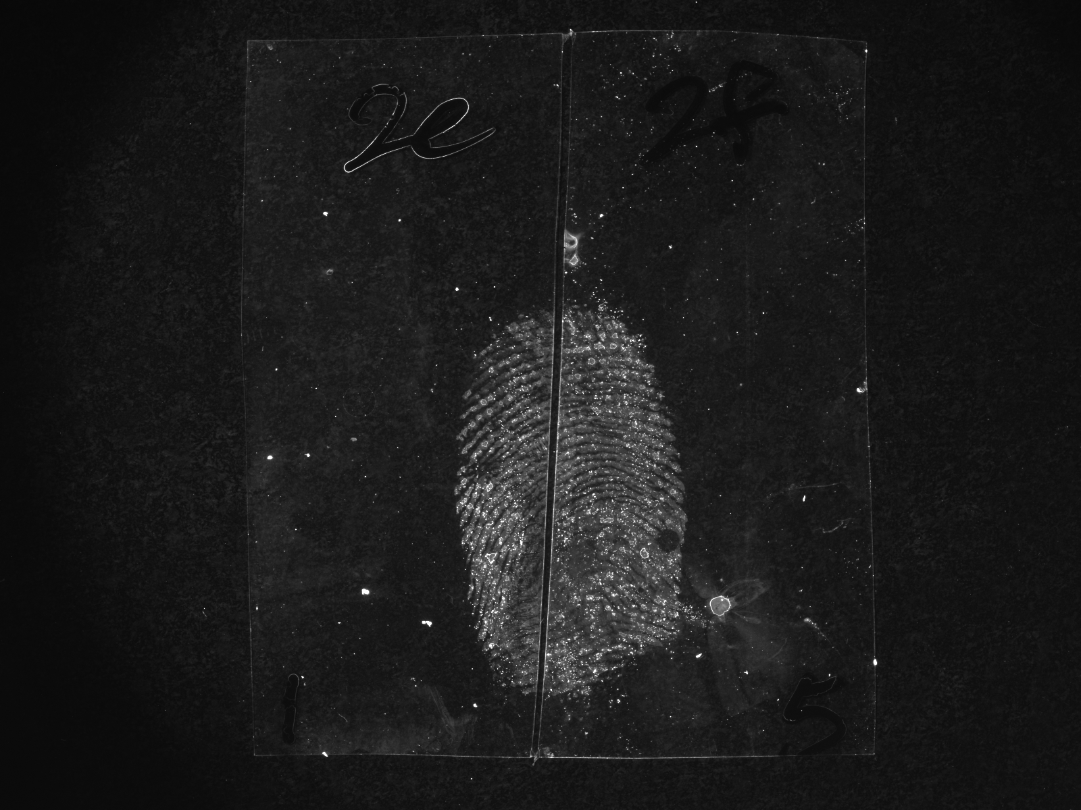
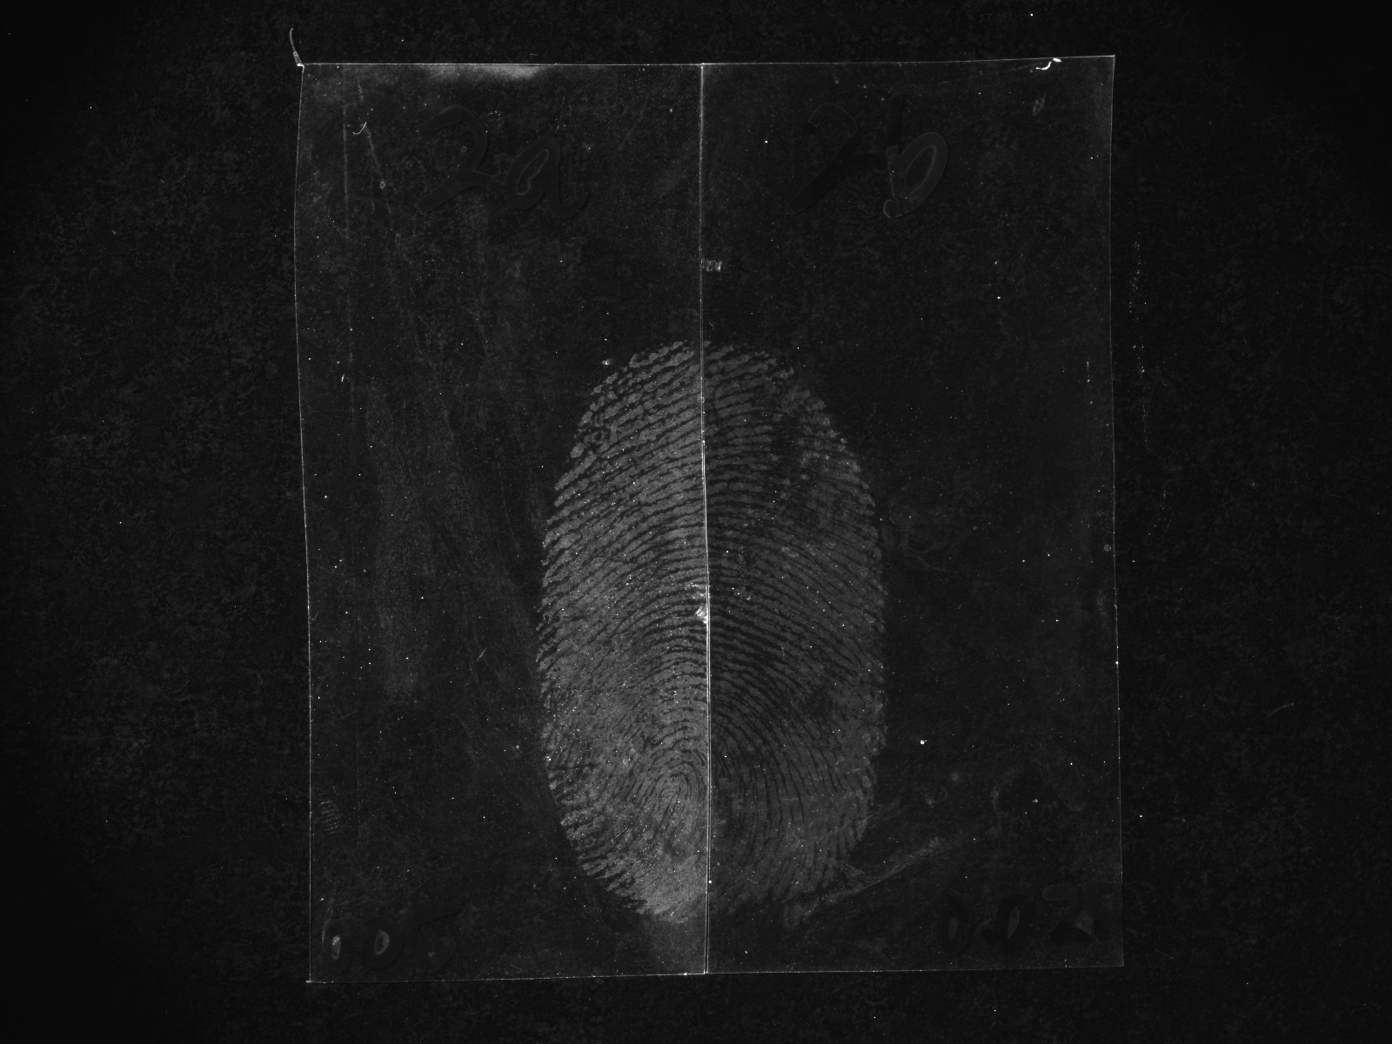
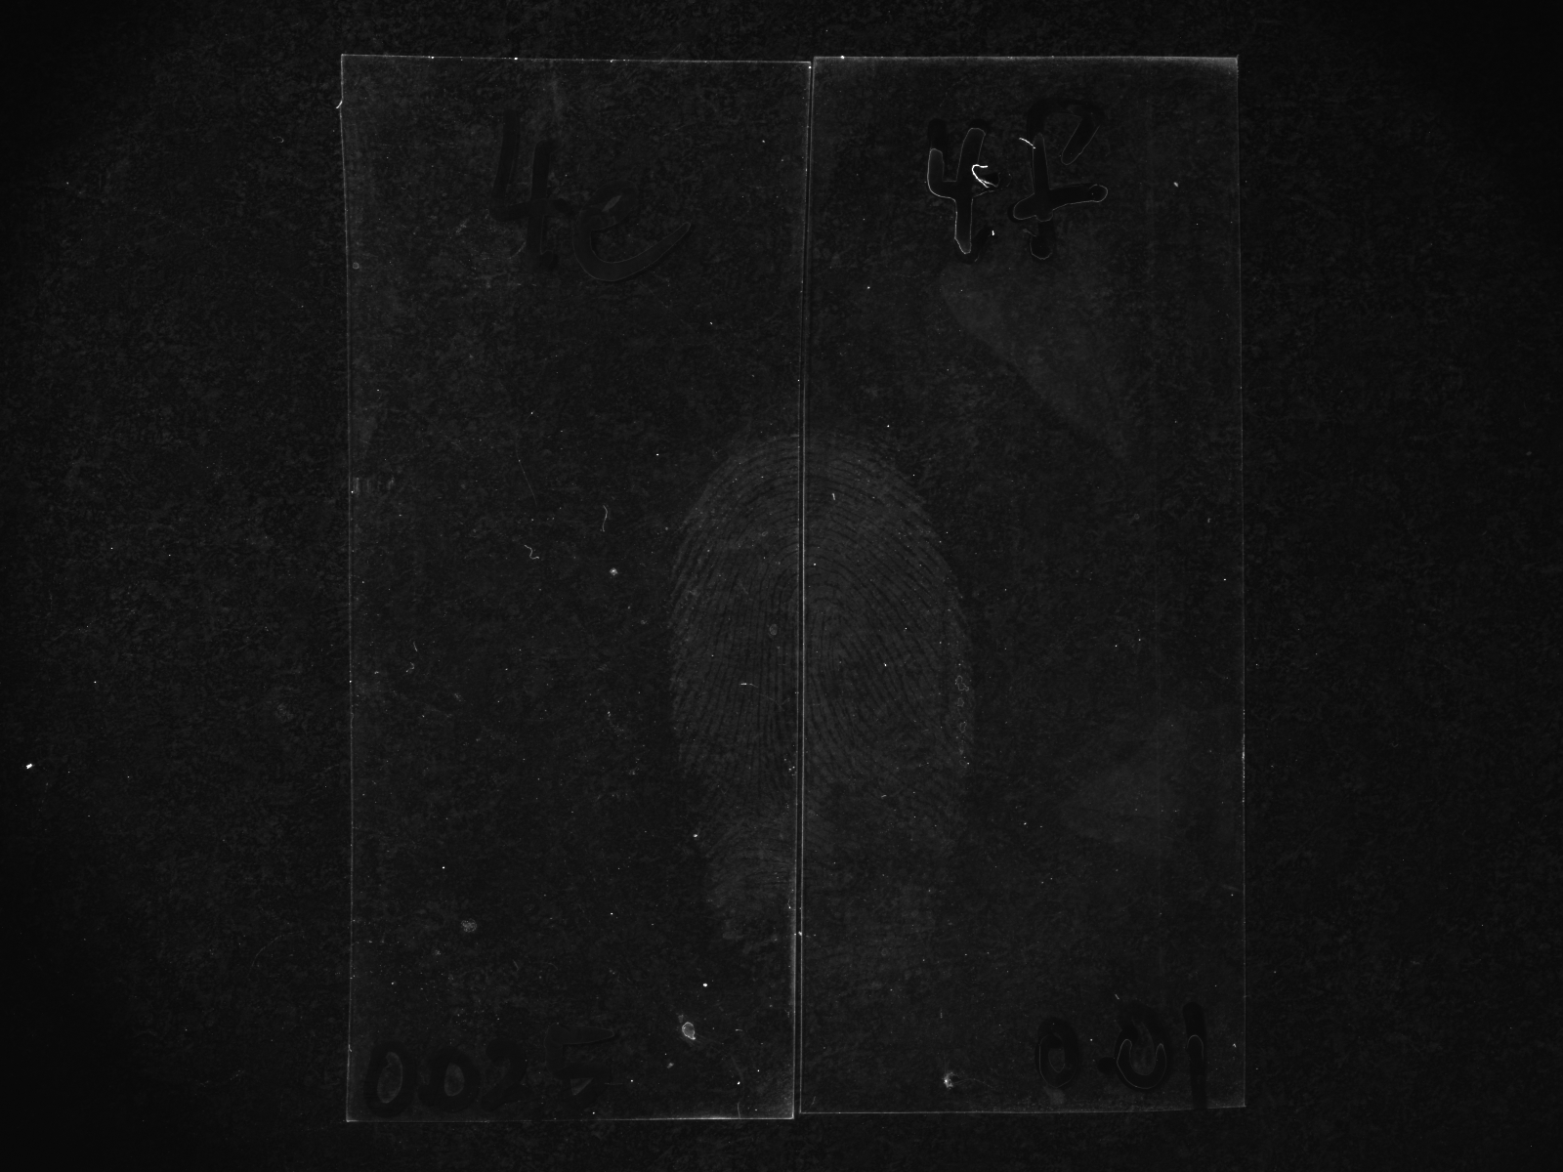
Concentration of the Nanoparticles
Transparent polypropylene
2x diluted
4x diluted
10x diluted
20x diluted
40x diluted
80x diluted
200x diluted

Slide 8
Concentration of the Nanoparticles
Detection quality increased with higher dilutions
At higher concentrations there are inter-nanoparticle attractions
  These attractions hinder interactions with fingermark residues
A 40x dilution was employed for the working formulation as a modification

Slide 9
Treatment Temperature and Time
The functionalised NPs are suggested to chemically interact with the fingermark secretions^{[1]}
Hypothesis: detection rate and detection effectiveness will increase at higher temperature, hence a shorter treatment time
Comparison experiments performed at 3°C, 23°C (room temperature) and 45°C
1. Moret, S., Bécue, A. & Champod, C. 2014, Nanotechnology, vol. 25, no. 42, p. 425502.

Slide 10
Treatment at Various Temperature Points
23°C
3°C
23°C
45°C
3°C
45°C

Slide 11
Treatment Temperature and Time
Detection effectiveness improved at higher temperature points
A possible shorter treatment time than one hour?
Comparison experiments performed at room temperature for one hour and 45°C with shorter treatment times

Slide 12
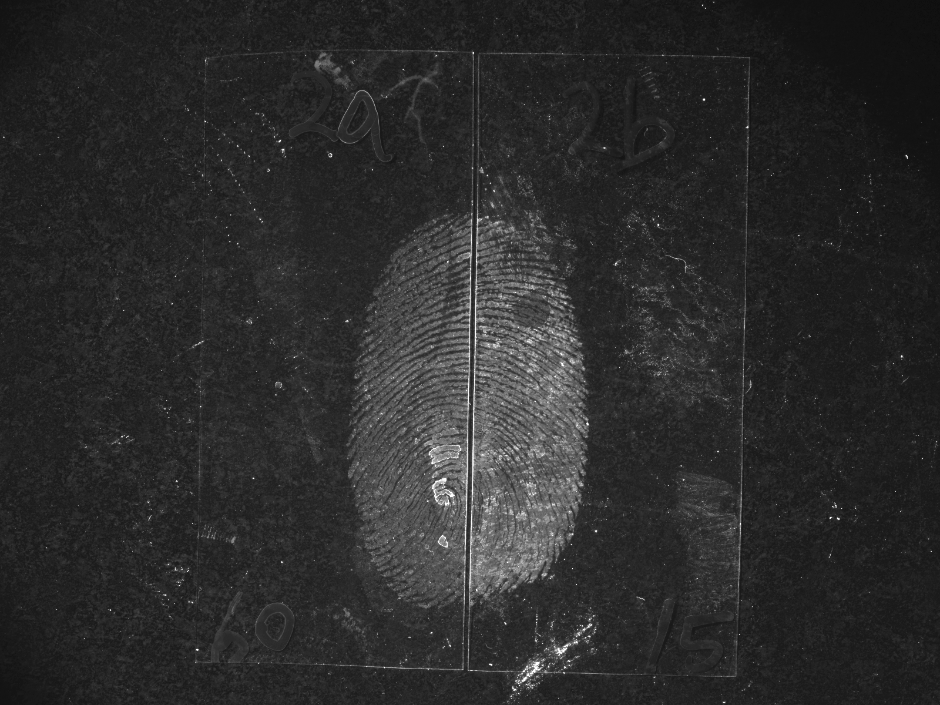
Shorter Treatment Times at Higher Temperature
1 hour (23°C)
15 min (45°C)
1 hour (23°C)
5 min (45°C)
15 min (45°C)
5 min (45°C)

Slide 13
Optimisation of Treatment Temperature and Time
Treatment temperature points
  30°C vs 35°C vs 40°C (reduction from 45°C)
Treatment time
  2 min vs 3 min vs 5 min
Treatment at 40°C for 5 min was incorporated as a modification

Slide 14
Optimised Treatment Temperature and Time
Aluminium foil
Transparent PP
Green PE
1 hour (23°C)
5 min (40°C)
1 hour (23°C)
5 min (40°C)
1 hour (23°C)
5 min (40°C)

Slide 15
Comparison of the Two Detection Parameters
SiO₂ NPs (2x diluted)
Room temperature
1 hour
Published
H₂O
5 mins
H₂O
5 – 10 mins
SiO₂ NPs (40x diluted)
35°C – 40°C
3 – 5 mins
Modified
H₂O
5 mins
H₂O
5 – 10 mins

Slide 16
Comparison of the Two Detection Parameters
Fingermark specimens
  3 donors (strong, average and weak)
  3 substrates (aluminium foil, transparent PP and green PE)
  2 age intervals (10 days and 3 months)
  4 fingers with 4 depletions
288 fingermark specimens were processed and evaluated
A comparative scoring system was used for fingermark assessment
  Based on the University of Canberra (UC) scale with the addition of a ”00” score

Slide 17
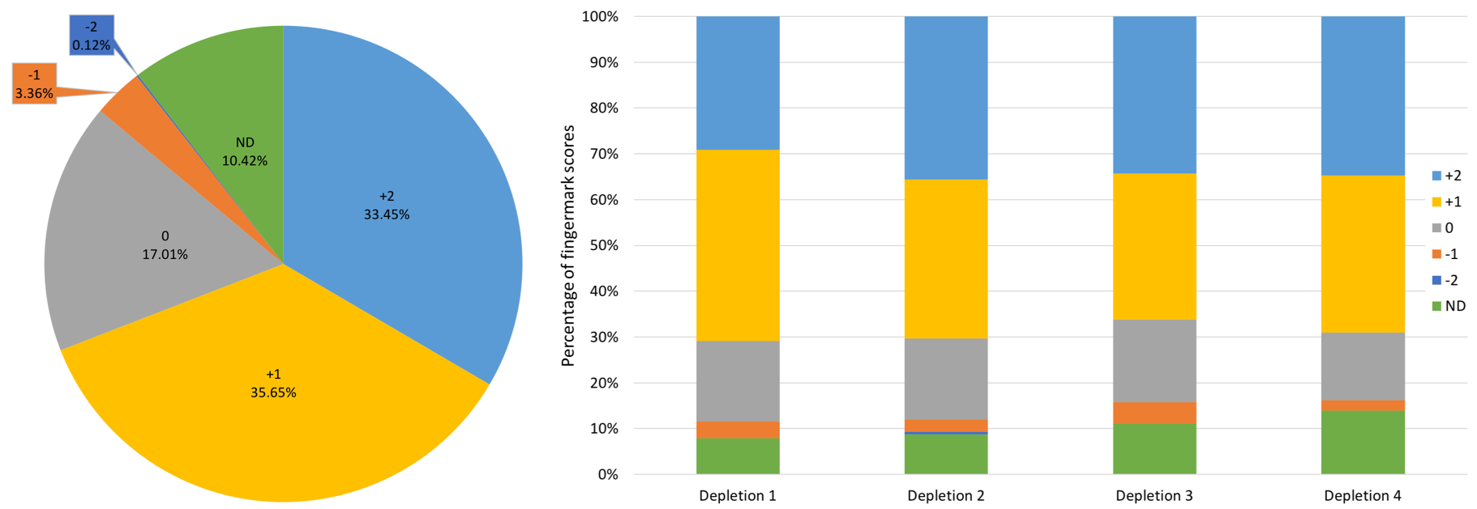
Overall Performance

Slide 18
Take-home Messages
Modification and optimisation of the published detection parameters
  Comparison study showed that the modified detection parameters gave superior results
A draft manuscript of the research findings is being finalised for journal submission
My parents still think I am doing a DNA project…(FFS)

Slide 19



Acknowledgements
Australian Research Council
  Linkage Project (LP160100351)
Rofin Australia Pty Ltd
Australian Federal Police
Victoria Police
ANZFSS NSW Branch Student Award

Slide 20
Questions
Timothy Lee
timothy.lee@westernsydney.edu.au

Slide 21
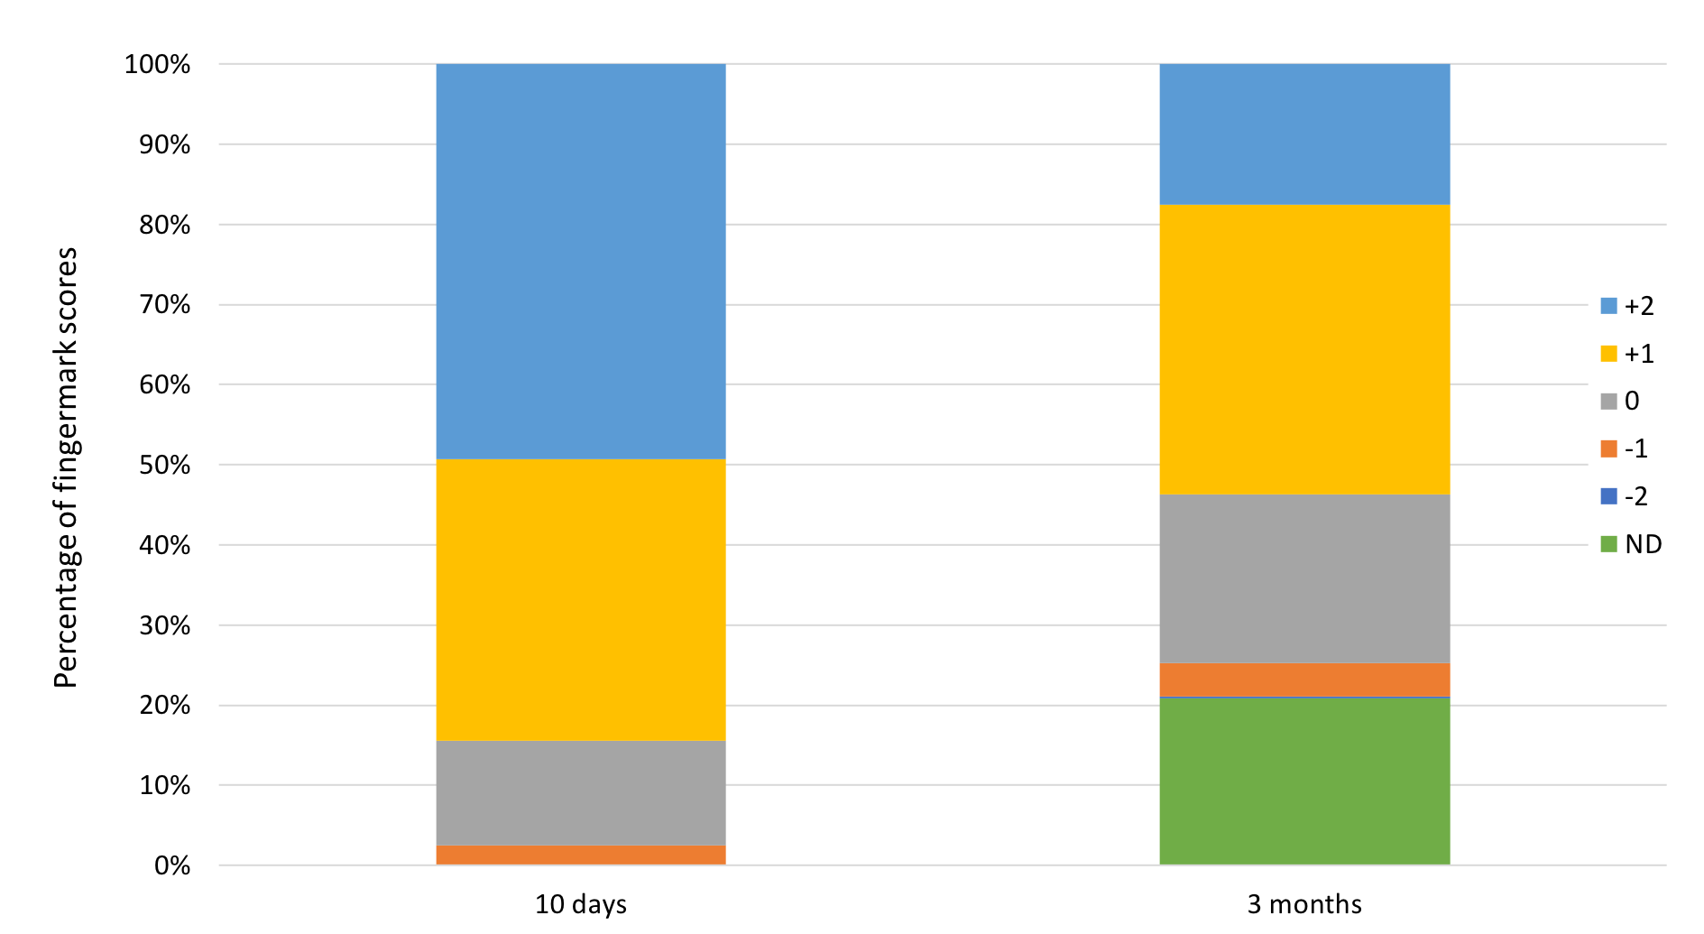
Effects of Fingermark Ages

