Slide 1
Next-generation Latent Fingermark Detection Using Functionalised Silicon Oxide Nanoparticles
Timothy Lee
PhD Candidate
Western Sydney University, School of Science and Health
Prof. Chris Lennard ¹
Prof. Claude Roux ²
Dr Sébastien Moret ²
Dr Fehmida Kanodarwala ²
Dr Xanthe Spindler ²
Dr Val Spikmans ¹
¹ Western Sydney University, School of Science and Health
² University of Technology Sydney, Centre for Forensic Science
ANZFSS NSW Branch Meeting – 10 October 2018

Slide 2
Why Silicon Oxide Nanoparticles?
Increasing research interest for latent fingermark detection in the past decade
Small size
  Average diameter of around 70 – 80 nm (via reversed micro-emulsion synthesis)^{[1,2]}
Versatile modifiable surface
  External layer of silanol (Si-OH) and siloxane (Si-O-Si) groups^{[3]}
Extended optical properties
  Potential of using a variety of dye molecules in their inner structure^{[1]}
1. Moret, S., Bécue, A. & Champod, C. 2014, Nanotechnology, vol. 25, no. 42, p. 425502.
2. Moret, S., Bécue, A. & Champod, C. 2016, Forensic Science International, vol. 259, pp. 10-8.
3. Bécue, A. & Cantú, A. 2012, Lee and Gaensslen's Advances in Fingerprint Technology, Third Edition, CRC Press, pp. 307-80.

Slide 3
Previous Research
An insight into the use of silicon oxide nanoparticles (SiO₂ NPs) for latent fingermark detection was published in 2016^{[2]}
A RuBpy-doped CES-functionalised SiO₂ NP reagent was proposed
A set of detection parameters was suggested for application
  A working formulation with the use of the functionalised NPs to detect latent fingermarks
2. Moret, S., Bécue, A. & Champod, C. 2016, Forensic Science International, vol. 259, pp. 10-8.

Slide 4
Research Aims
Research in a Nutshell – TL;DL Version
Design and synthesise a novel SiO₂-based NPs for improved fingermark detection
Optimise and validate the technique for latent fingermark detection
The novel and validated technique will be applicable in standard police laboratories as a user-friendly latent fingermark detection method
Make something new
Make it work
Make it better and actually usable

Slide 5
Concentration of the Nanoparticles
The functionalised NPs are diluted by half in the working formulation^{[2]}
  How much is actually enough to detect latent fingermarks?
  An optimum concentration
Different NP concentrations were compared against the published formulation^{[2]}
  4x, 10x, 20x, 40x, 80x and 200x dilutions of the NPs
2. Moret, S., Bécue, A. & Champod, C. 2016, Forensic Science International, vol. 259, pp. 10-8.

Slide 6
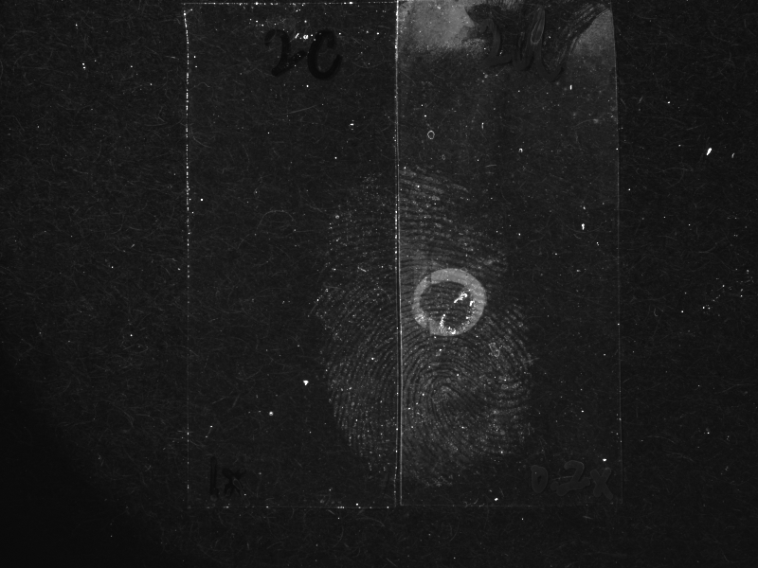
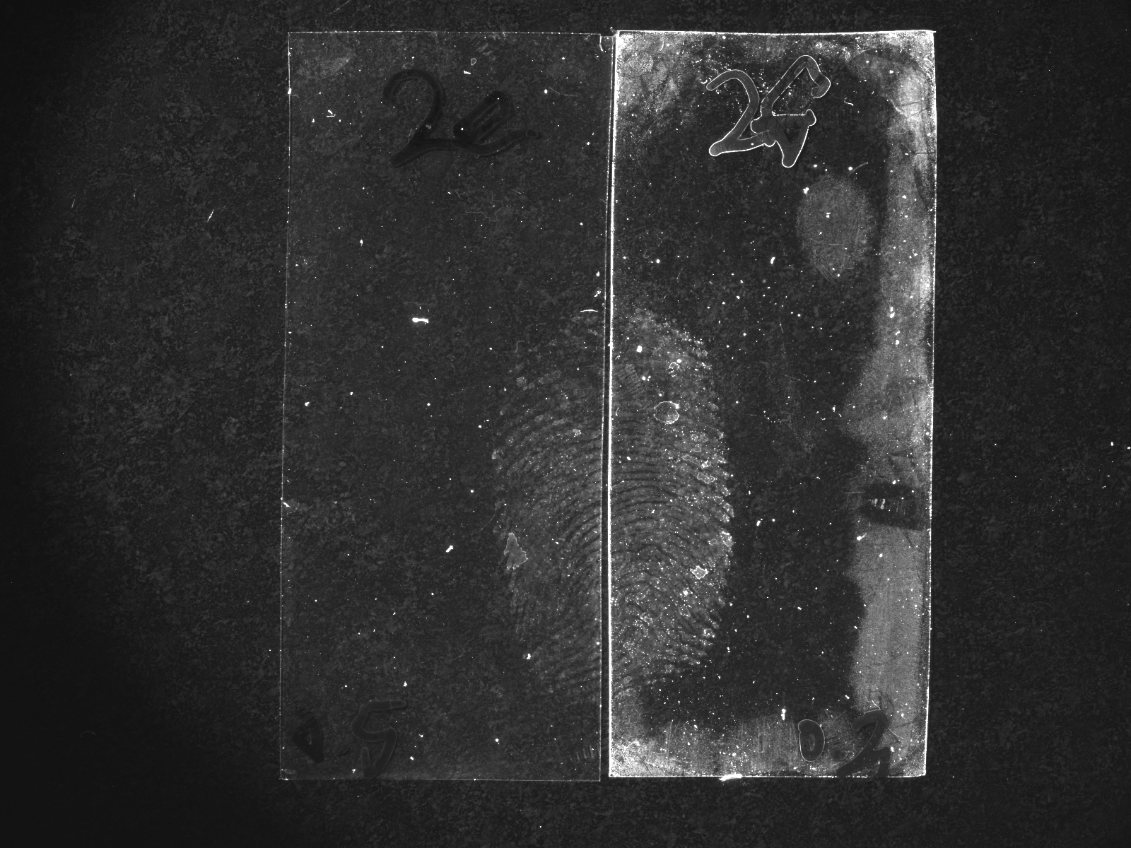
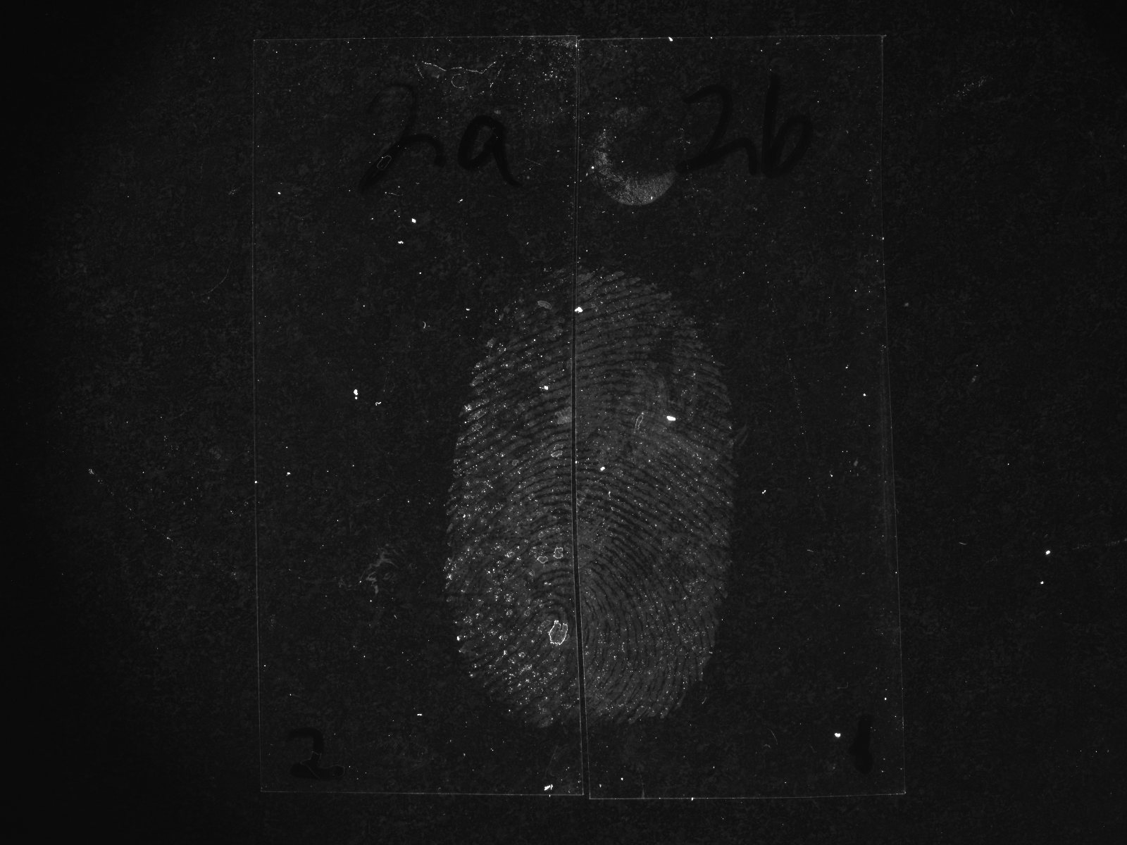
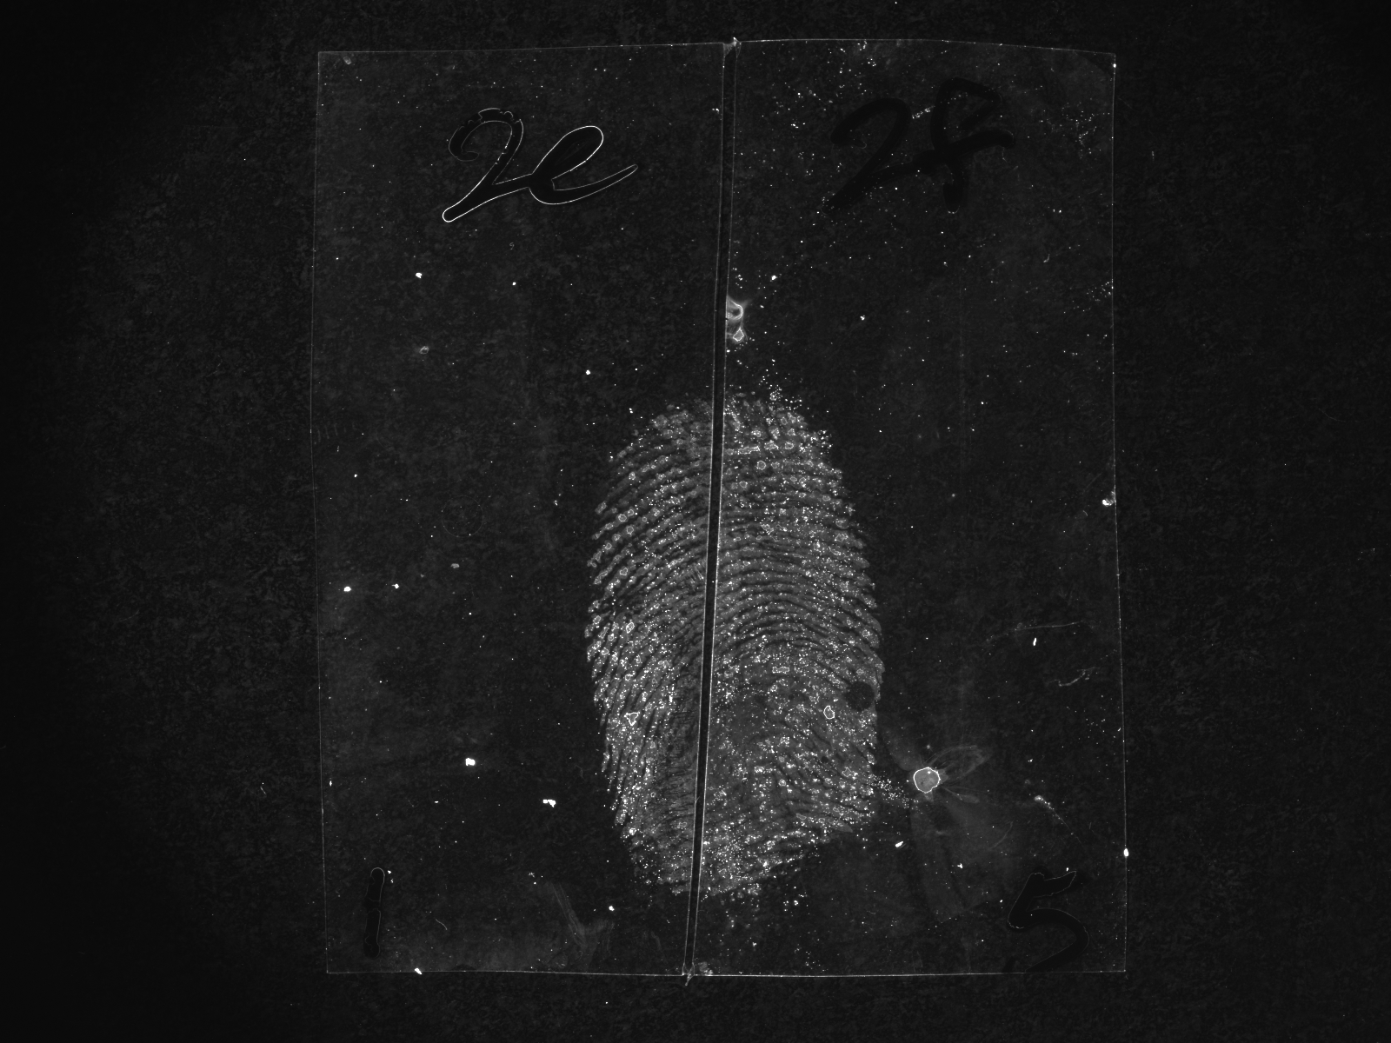
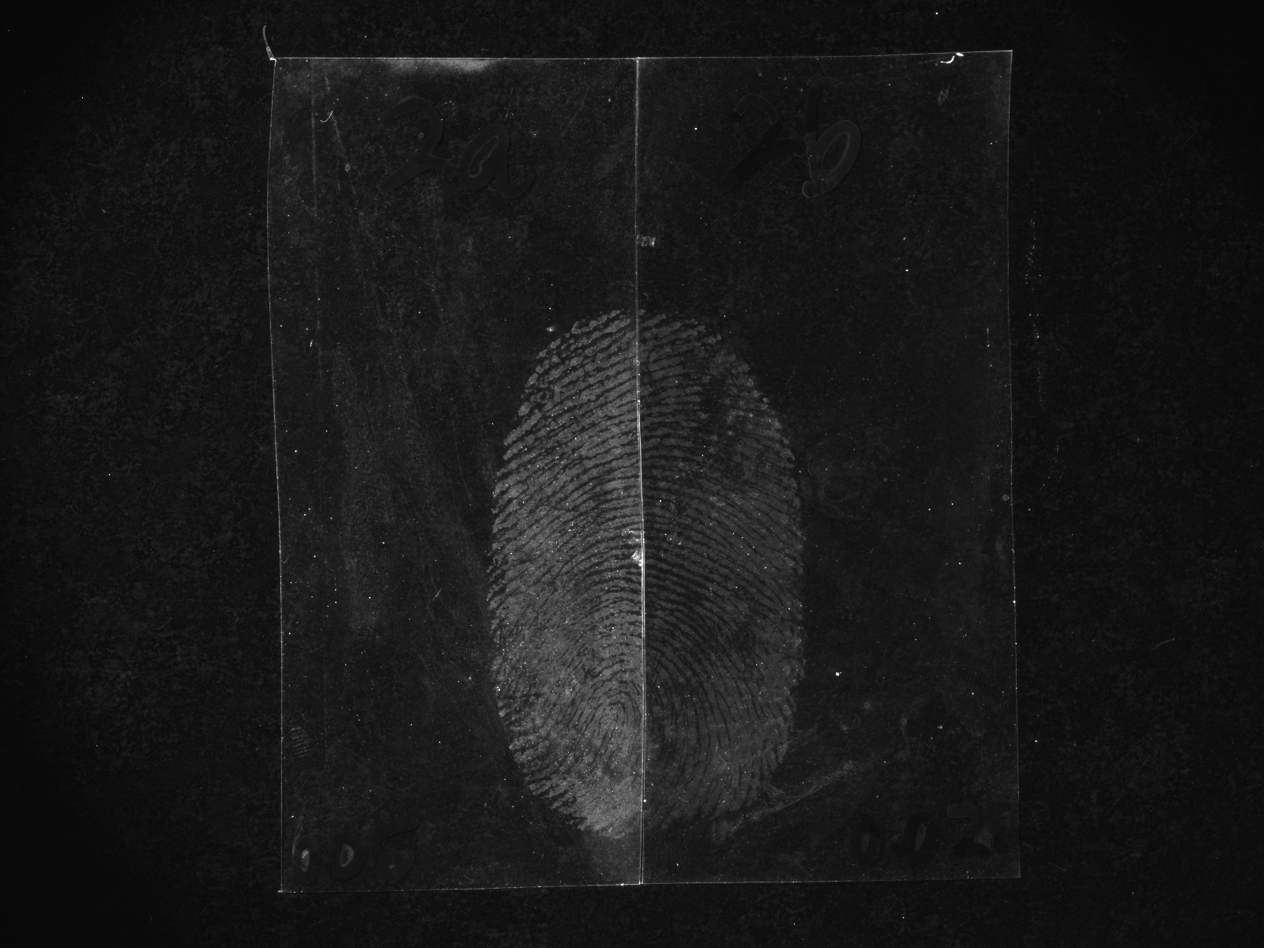
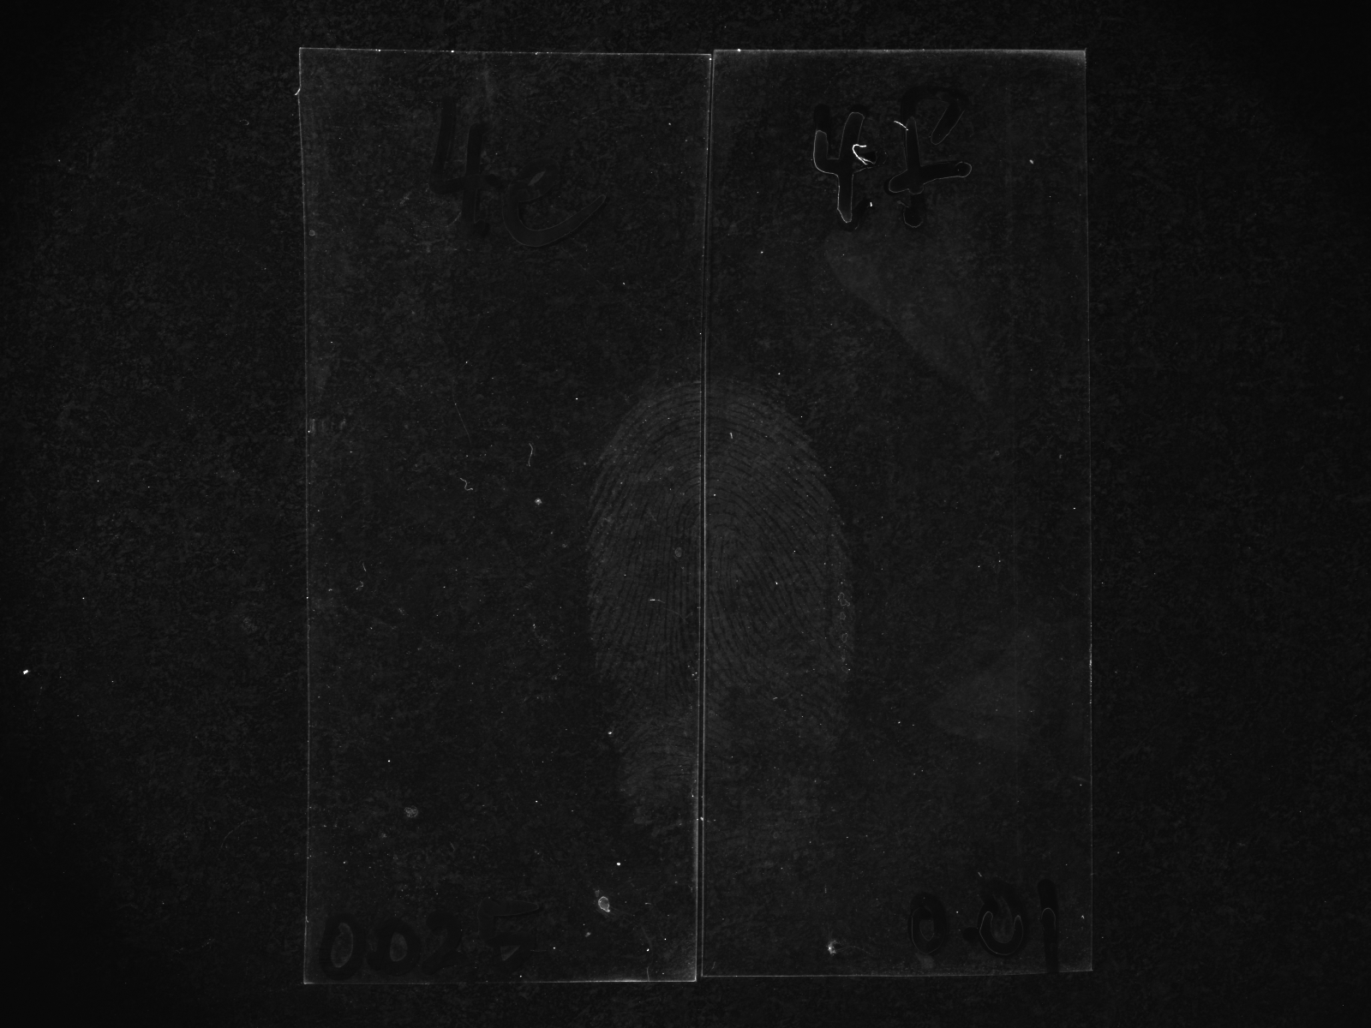
Concentration of the Nanoparticles
Transparent polypropylene
2x diluted
4x diluted
10x diluted
20x diluted
40x diluted
80x diluted
200x diluted

Slide 7
Concentration of the Nanoparticles
Detection quality increased with higher dilutions
At higher concentrations there are inter-nanoparticle attractions
  These attractions hinder interactions with fingermark residues
A 40x dilution was employed for the working formulation as a modification

Slide 8
Treatment Temperature and Immersion Time
The functionalised NPs are suggested to chemically interact with the fingermark secretions^{[1]}
Hypothesis: detection rate and detection effectiveness will increase at higher temperature, hence a shorter immersion time
Comparison experiments performed at 3°C, 23°C (room temperature) and 45°C
1. Moret, S., Bécue, A. & Champod, C. 2014, Nanotechnology, vol. 25, no. 42, p. 425502.

Slide 9
Treatment at Various Temperature Points
23°C
3°C
23°C
45°C
3°C
45°C

Slide 10
Treatment Temperature and Immersion Time
Detection effectiveness improved at higher temperature points
A possible shorter immersion time than one hour?
Comparison experiments performed at room temperature for one hour and 45°C with shorter immersion times

Slide 11
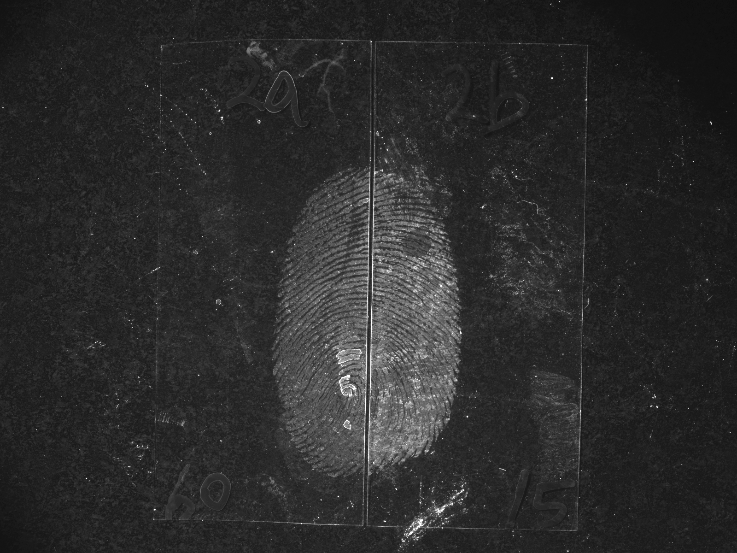
Shorter Immersion Times at Higher Temperature
1 hour (23°C)
15 min (45°C)
1 hour (23°C)
5 min (45°C)
15 min (45°C)
PAGE 10
5 min (45°C)

Slide 12
Optimised Treatment Temperature and Immersion Time
Treatment temperature points
  30°C vs 35°C vs 40°C (reduction from 45°C)
Immersion time
  2 min vs 3 min vs 5 min
Treatment at 40°C for 5 min was incorporated as a modification

Slide 13


Detection Parameters
SiO₂ NPs (2x diluted)
Room temperature
1 hour
Published
H₂O
5 mins
H₂O
5 – 10 mins
SiO₂ NPs (40x diluted)
35°C – 40°C
3 – 5 mins
Modified
H₂O
5 mins
H₂O
5 – 10 mins

Slide 14
Comparison of the Two Detection Parameters
Natural fingermark specimens
  3 donors (strong, average and weak)
  3 substrates (aluminium foil, transparent PP and green PE)
  2 age intervals (10 days and 3 months)
  4 fingers with 4 depletions
288 fingermark specimens were processed and evaluated
A comparative scoring system was used for fingermark assessment
  Based on the University of Canberra (UC) scale

Slide 15
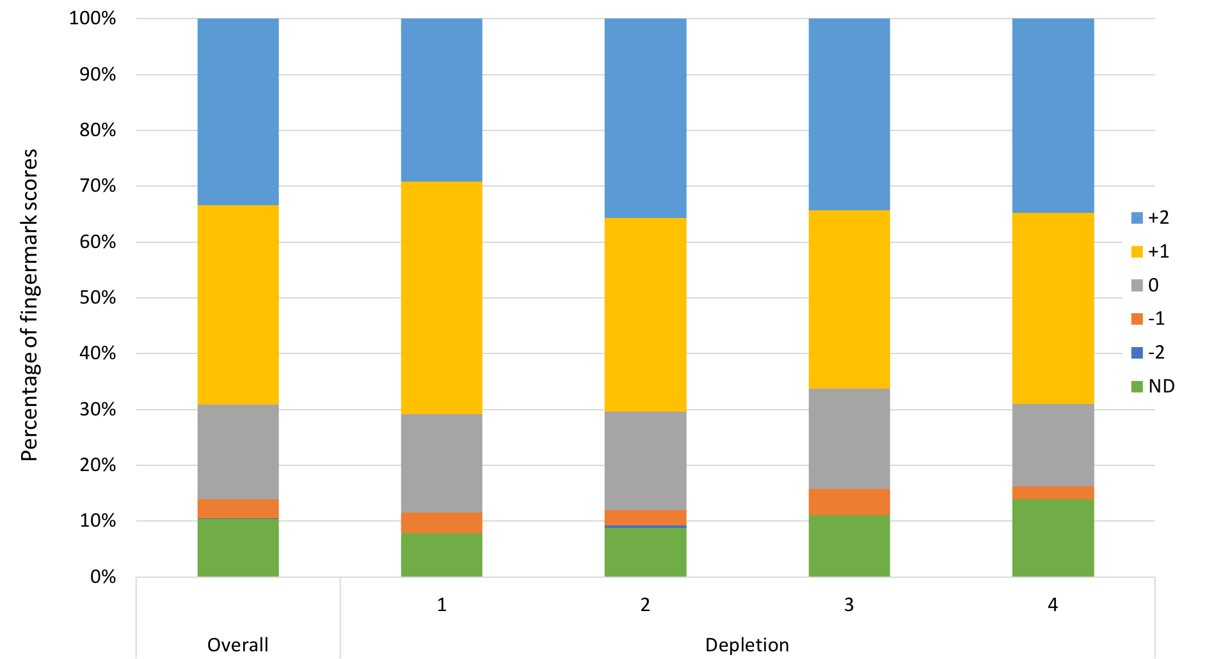
Overall Performance

Slide 16
Take-home Messages
Modification and optimisation of the published detection parameters
  A shorter immersion time (5 min) at a higher temperature (40°C) during fingermark treatment can significantly improve detection quality
  Comparison study showed that the modified detection parameters gave superior results
A manuscript of the research findings has been submitted for publication
My parents still think that I am doing a DNA project…

Slide 17



Acknowledgements
Australian Research Council
  Linkage Project (LP160100351)
Rofin Australia Pty Ltd
Australian Federal Police
Victoria Police
ANZFSS NSW Branch Award

Slide 18
Questions
Timothy Lee
timothy.lee@westernsydney.edu.au

