Slide 1
Next-generation Latent Fingermark Detection Using Functionalised Silicon Oxide Nanoparticles
Timothy Lee
PhD Candidate
Western Sydney University, School of Science and Health
Prof. Chris Lennard ¹
Prof. Claude Roux ²
Dr Fehmida Kanodarwala ²
Dr Sébastien Moret ²
Dr Xanthe Spindler ²
Dr Val Spikmans ¹
¹ Western Sydney University, School of Science and Health
² University of Technology Sydney, Centre for Forensic Science
2019 3rd International Conference on Materials Sciences and Nanomaterials – 23 July 2019

Slide 2
Fingermark Evidence in Forensic Science
Early days of dactyloscopy (fingerprinting)
  Pioneer studies dated back to the end of the 19th century^{[1]}
  Argentina became the first country to formally file criminal records solely using fingerprints in 1896^{[2]}
  It has since been the foundation of forensic identification for more than a century
The gold standard of forensic identification in criminal investigations
  The ”never-change-in-a-lifetime” feature of human fingerprints
  SUPERIOR (able to differentiate identical twins, unlike DNA) discriminating power
1. Aaron, J.U. 2010, Forensic Dentistry, Second Edition, CRC Press, pp. 79-102.
2. Vivianne, G. & Dave, C. 2006, Forensic Human Identification, CRC Press, pp. 56-72.

Slide 3
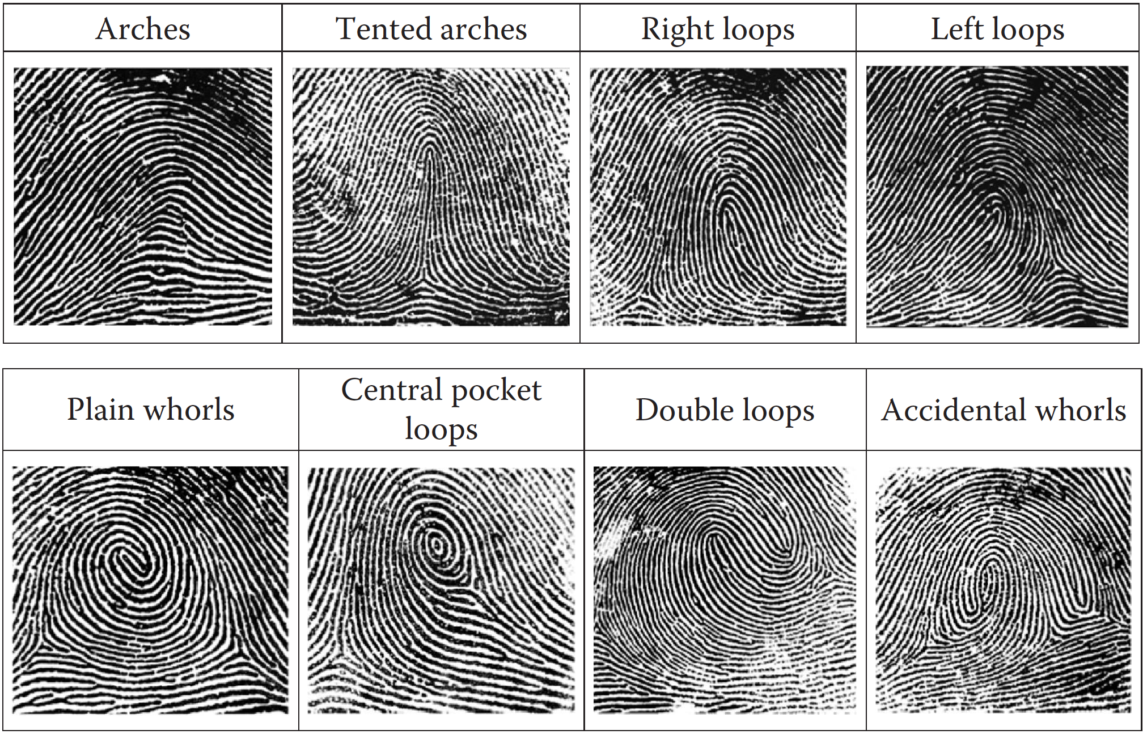
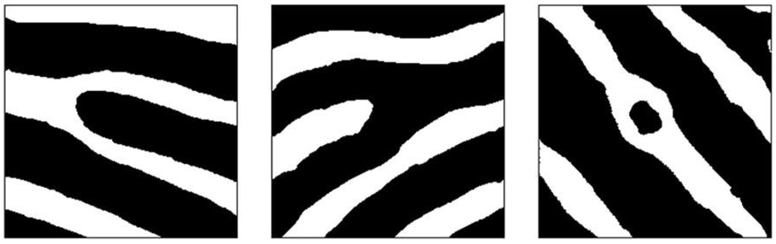
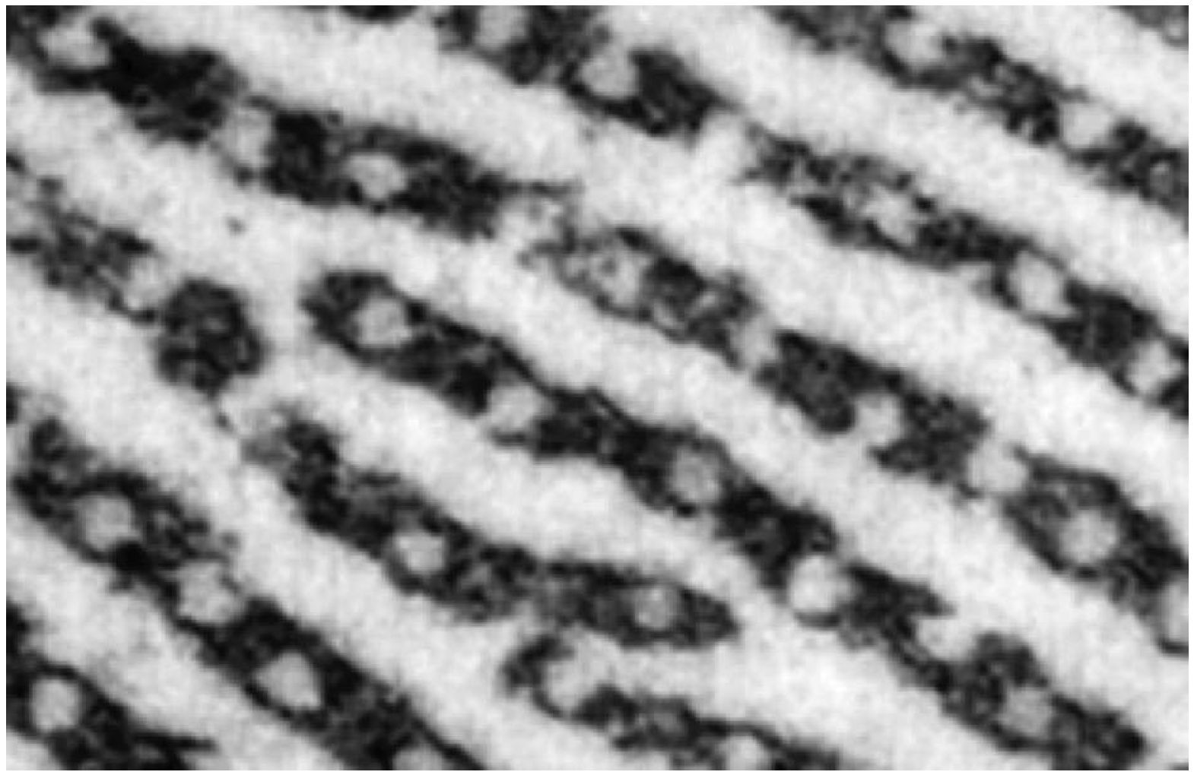
The Human Fingerprints
Three levels of friction ridge skin features^{[3]}
  Level 1 – basic general patterns
  Level 2 – minutiae
  Ridge ending
  Bifurcation
  Dot
  Level 3 – pores
3. Champod, C., Lennard, C., Margot, P. & Stoilovic, M. 2016, Fingerprints and Other Ridge Skin Impressions, CRC Press, pp. 37-38.

Slide 4
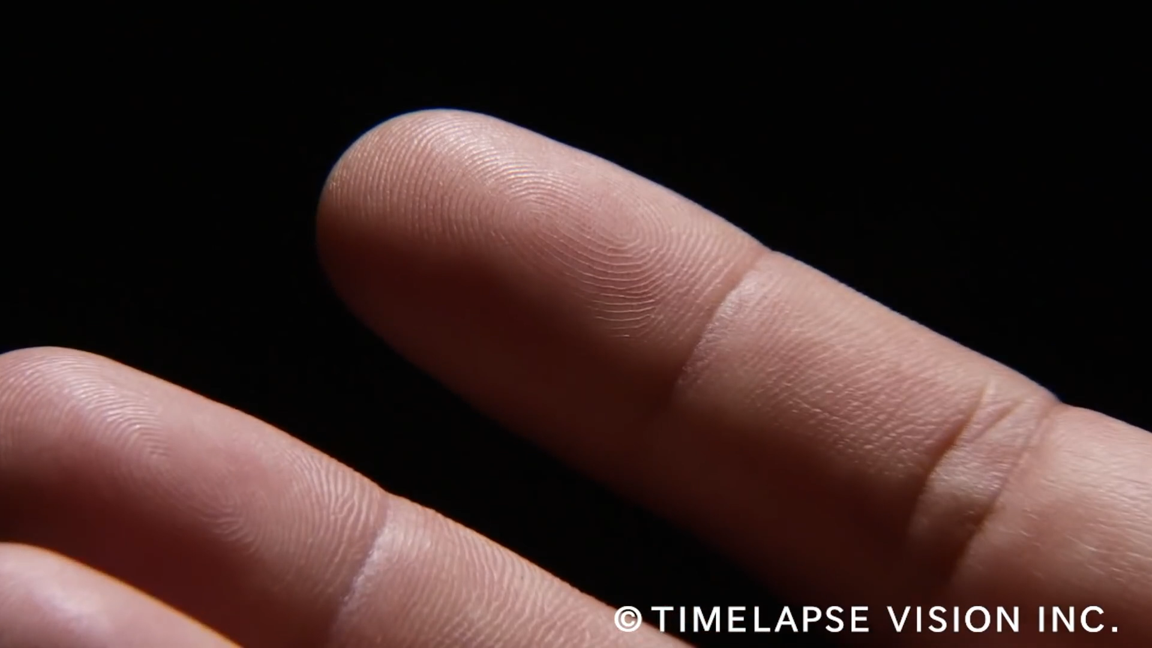
Latent Fingermarks
Chemical constituents of the human fingermarks
  Sources – Eccrine (aqueous secretions) and sebaceous glands (lipid secretions)
  Latent fingermark residues are therefore a combination of water and non-water soluble components
  Amino acids and lipids are two major groups of constituents of latent fingermark residues
Video: TIMELAPSE VISION. 2016, Fingerprints and sweat glands, Available at: https://www.youtube.com/watch?v=lOaFeGreAJw.

Slide 5
Latent Fingermark Detection and Enhancement
Various conventional techniques
  Powder dusting
  Amino acid reagents (e.g. 1,2-indanedione-zinc and ninhydrin)
  Cyanoacrylate (CA) fuming + luminescent dye staining
  Metal deposition
Major drawbacks of conventional techniques
  Inabilities to develop fingermarks on substrates with complex background chemistries
  Struggle to detect some fingermarks that are present^{[4]}
Need of new techniques
4. Chadwick, S., Moret, S., Jayashanka, N., Lennard, C., Spindler, X. & Roux, C. 2018, Forensic Science International, vol. 289, pp. 381-9.

Slide 6



Silicon Oxide Nanoparticles
Versatile modifiable surface^{[5]}
+ extended optical properties^{[6]}
+ small size^{[6,7]}
5. Bécue, A. & Cantú, A. 2012, Lee and Gaensslen's Advances in Fingerprint Technology, Third Edition, CRC Press, pp. 307-80.
6. Moret, S., Bécue, A. & Champod, C. 2014, Nanotechnology, vol. 25, no. 42, p. 425502.
7. Moret, S., Bécue, A. & Champod, C. 2016, Forensic Science International, vol. 259, pp. 10-8.

Slide 7
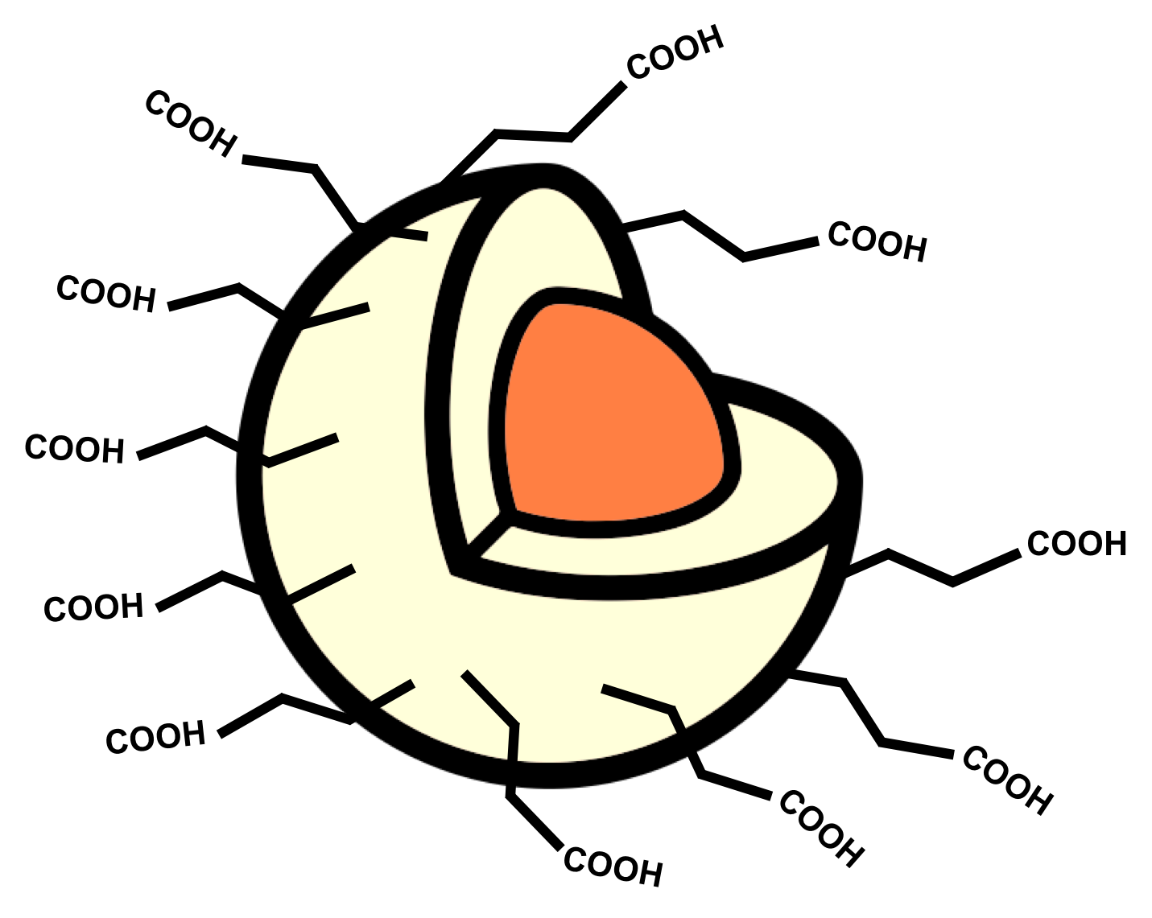


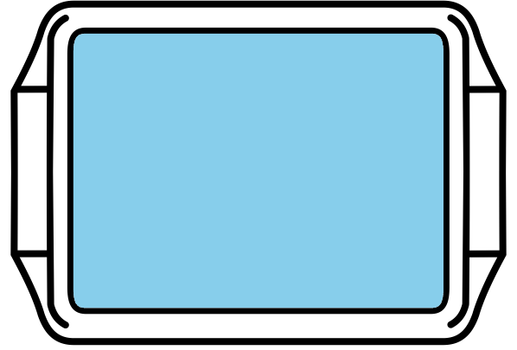


How Does It Work?
48 hours
RuBpy-doped (core)
CES (carboxyethylsilanetriol)-functionalised SiO₂ NPs
Synthesis
Rinse
H₂O
Colloidal dispersion
RuBpy-CES-SiO₂ NPs
Rinse
H₂O
Application
450 nm
excitation
Visualisation
590 nm
emission

Slide 8
Luminescent Fingermarks
An example of a latent fingermark detected and enhanced with RuBpy-doped CES-SiO₂ NPs
Visualised in luminescence mode with 450 nm excitation and observation at 590 nm

Slide 9
Modification and Optimisation of Detection Parameters
Insights from a previous study^{[7]}
  Promising new latent fingermark detection technique
  Optimisation of detection parameters required
Modification and optimisation of the previous detection parameters
  Lower concentration of NPs used in the working colloidal dispersion
  Higher treatment temperature with shorter immersion time
  Comparison study showed that the modified detection parameters gave superior results^{[8]}
7. Moret, S., Bécue, A. & Champod, C. 2016, Forensic Science International, vol. 259, pp. 10-8.
8. Lee, P.L.T., Kanodarwala, F.K., Lennard, C., Spindler, X., Spikmans, V., Roux, C. & Moret, S. 2019, Forensic Science International, vol. 298, pp. 372-83.

Slide 10
Modified Detection Parameters
Colloidal dispersion
Rinse
H₂O
5 min
2x dilution of the NPs
Rinse
H₂O
5 – 10 min
Previous
Room temperature
1 hour immersion
Colloidal dispersion
Rinse
H₂O
5 min
40x dilution of the NPs
Rinse
H₂O
5 – 10 min
Modified
40 °C on a hot plate
5 min immersion

Slide 11
Results
Aluminium foil
Transparent polypropylene
Green polyethylene
Previous
Modified
Previous
Modified
Previous
Modified

Slide 12
Refinement of the Surface Functionalisation
Different concentrations of CES used in synthesis for surface functionalisation
  –COOH, carboxyl functionalisation
  NPs synthesised with lower concentrations showed improvements on detection quality
Comparisons of 100%, 80%, 60% and 50% of CES
  50 – 60% of CES (of the original amount) is suggested to be the optimum concentration
  Lowering the amount of CES used increases detection quality
  With the original amount of CES used (100%), the SiO₂ NP surface is “over-occupied” by CES molecules
  This negatively impacts the degree of effective interactions between CES molecules and fingermark residues

Slide 13
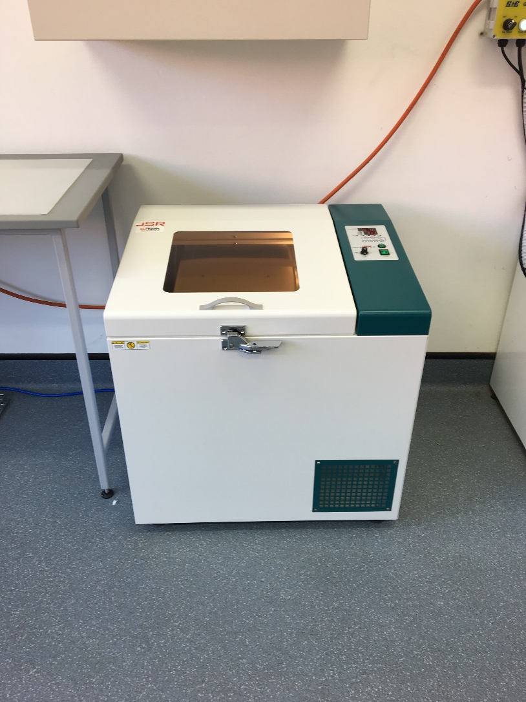
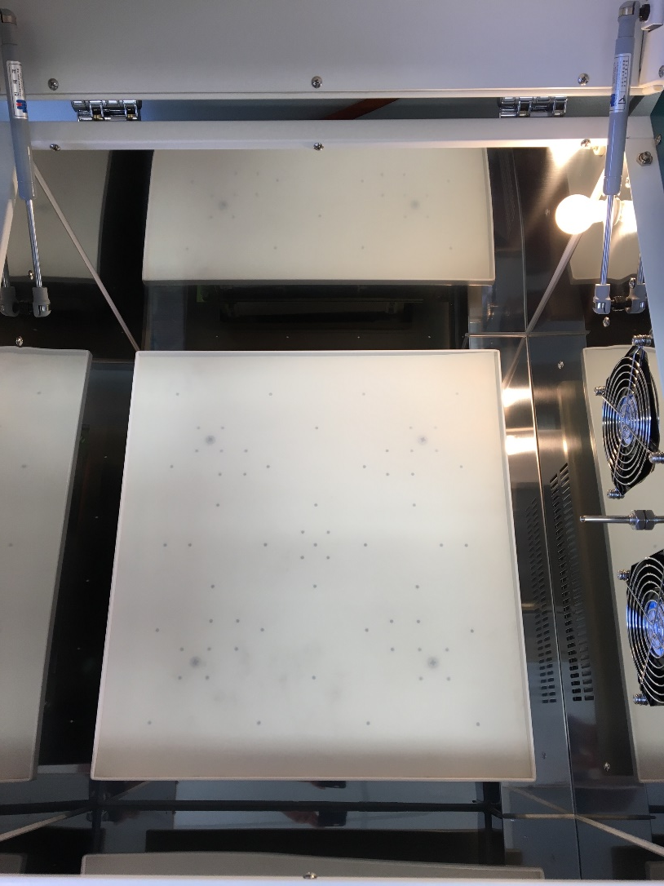
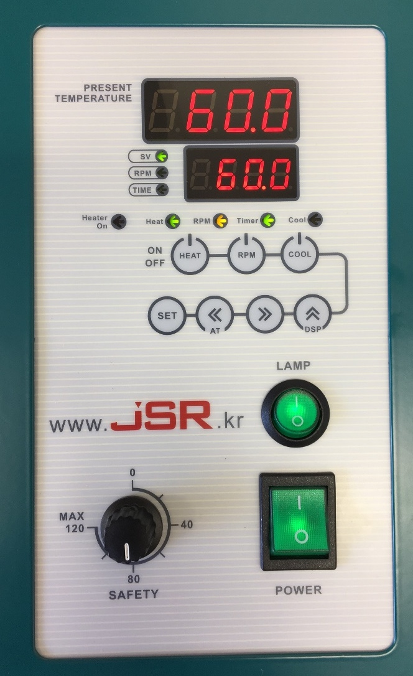
Simplified Application
Treatment using a shaking incubator to replace hot plate for improved practicality

Slide 14
Latest Detection Parameters
Shaking incubator is a practical alternative to hot plate treatment
  Comparison with hot plate treatment showed no difference in detection quality
  More steady temperature control
  Capacity to treat larger and more items simultaneously
50% CES-SiO₂ with shaking incubator treatment
  Improved “sensitivity” of the processed fingermark specimens from using 50% CES-SiO₂ NPs with shaking incubator than 100% CES-SiO₂ NPs with hot plate treatment

Slide 15
Comparison with a Conventional Method
Comparison of the SiO₂ NPs (with the latest detection parameters) with a benchmark technique – cyanoacrylate fuming (CAF) + rhodamine 6G (R6G) staining
6 Donors
3 males
3 females
6 Substrates
Al foil | PP | PE
glass | paint | tile
3 Ages
1 | 3 | 6 months
4 Fingers
4 depletions
CAF + R6G
SiO₂ NPs
3456 fingermarks

Slide 16
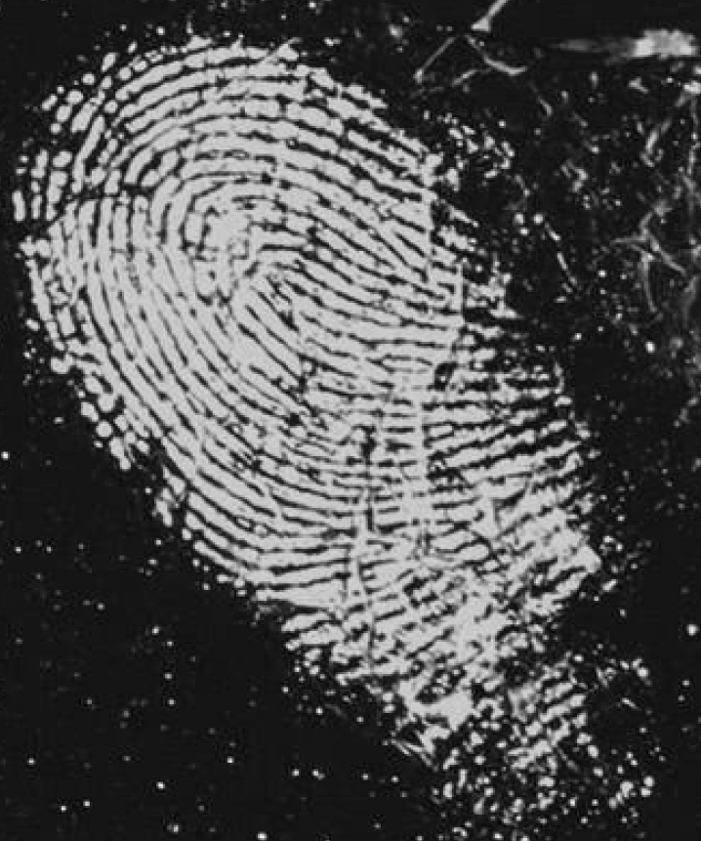
Cyanoacrylate Fuming + Luminescent Dye Staining
CAF + R6G developed fingermark
Cyanoacrylate (CA) fuming^{[3]}
  CA liquids are colourless polyesters that interact with latent fingermark residues and form hard, white polymers over ridges
  Commercially available and widely accepted since late 1970s for latent fingermark development on non-porous surfaces
Luminescent dye staining for CA fumed fingermarks^{[3]}
  Immersion of CA treated fingermarks into a luminescent dye solution for application
  Rhodamine 6G (R6G) has a high luminescence efficiency and is commonly used
Visualisation:
530 nm excitation
590 nm emission
3. Champod, C., Lennard, C., Margot, P. & Stoilovic, M. 2016, Fingerprints and Other Ridge Skin Impressions, CRC Press, pp. 37-38.

Slide 17
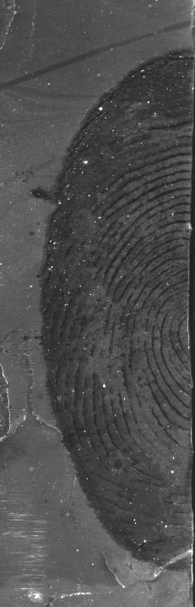
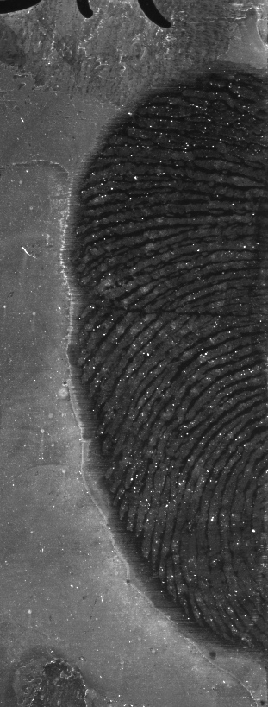
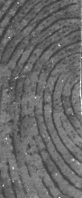
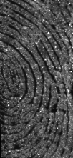
Results – 1-month-old Fingermarks
Aluminium foil
Aluminium foil
Green polyethylene
RuBpy-CES-SiO₂ NPs
450 nm; 590 nm
CAF + R6G
530 nm; 590 nm
RuBpy-CES-SiO₂ NPs
450 nm; 590 nm
CAF + R6G
530 nm; 590 nm
RuBpy-CES-SiO₂ NPs
450 nm; 590 nm
CAF + R6G
530 nm; 590 nm

Slide 18
Conclusions
RuBpy doped CES-functionalised SiO₂ NPs for latent fingermark development has been modified and optimised
Preliminary comparison results with CAF + R6G (a benchmark technique) show that
  CAF + R6G is more donor-dependent
  SiO₂ NPs method is more substrate-dependent
Work to utilise upconverting nanoparticles (UCNPs) with SiO₂ shell is underway within our research group

Slide 19
Questions for the audience
Some research hurdles so far
Not applicable on glass surface
Background staining problem on aluminium foil
Difficulties to synthesise UCNPs@SiO2 shell

Slide 20



Acknowledgements
Australian Research Council
  Linkage Project (LP160100351)
Rofin Australia Pty Ltd
Australian Federal Police
Victoria Police
WSU-UTS Fingerprint Research Group

Slide 21







21-25 September 2020
Sydney, Australia
www.iafs2020.com.au
iafs2020@arinex.com.au
iafs2020

Slide 22
Questions
Timothy Lee
timothy.lee@westernsydney.edu.au

