Slide 1
Latest developments in latent fingermark detection using functionalised silicon oxide nanoparticles
Fehmida Kanodarwala¹, Po Lun (Timothy) Lee², Sebastien Moret¹, Xanthe Spindler¹, Val Spikmans², Chris Lennard², Claude Roux¹
Centre for Forensic Science, University of Technology Sydney, Broadway NSW
School of Science & Health, Western Sydney University, Richmond, NSW

Slide 2
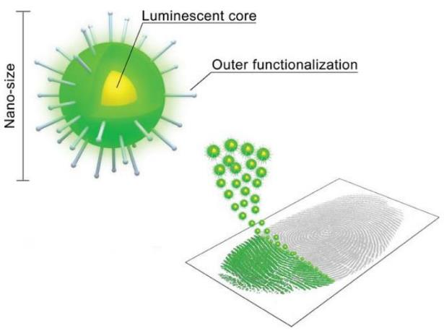
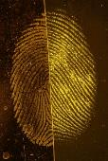
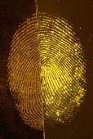
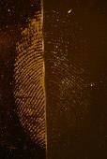
Silicon oxide nanoparticles
Triad of ideal properties
→ theoretical specificity and high signal
Proof-of-concept studies → potential for detection
SiO₂
CA
Bécue A., Moret S. et al., Biotechnics & Histochemistry, 86, 140-160, 2011.
S. Moret, A. Bécue, C. Champod, 2014, Nanotechnology, 25(42), p. 425502
S. Moret, A. Bécue, & C. Champod, 2016, Forensic Science International, 259, pp. 10-8
F. Kanodarwala, S. Moret, X. Spindler, C. Lennard, C. Roux, 2019, WIREs Forensic Science, DOI: 10.1002/wfs2.1341
PL. Lee, F. Kanodarwala, C. Lennard, X. Spindler, V. Spikmans, C. Roux, S. Moret, Forensic Science International, 294, pp. 103-112
Notes:
Average diameter of around 70 – 80 nm (via reversed micro-emulsion synthesis)
External layer of silanol (Si-OH) and siloxane (Si-O-Si) groups
Potential of using a variety of dye molecules in their inner structure
Lower donor dependence than existing methods

Slide 3
State of play: 2017
Not yet suitable for casework
Optimisation required:
  Simplify synthesis
  Broaden optical ‘tool kit’
  Improve interaction with fingermarks
  Simplify application
  Sequencing with routine techniques
Notes:
Problems with some substrates (e.g. glass and certain types of plastic)
Improvements in sensitivity and selectivity through modifying surface chemistry
Making progress on all aspects – presentation will focus on highlighted parameters (animation)

Slide 4
Improving interaction with fingermarks

Slide 5
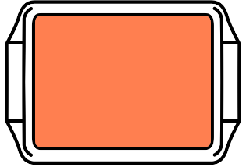
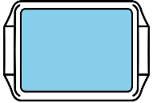











Optimisation
Moret, S., Bécue, A. & Champod, C. 2016, Forensic Science International, vol. 259, pp. 10-8
SiO₂ NPs
2.5 mg/mL
Room temperature
1 hour
H₂O
5 min
H₂O
5 – 10 min
Original formulation: 50% dilution of as-synthesised dispersion
3
Donors
3
Substrates
10d | 2m
4
Depletions
Split marks
6
Dilutions
4x 10x
20x 40x
80x 200x
Notes:
Dilutions relative to original concentration
Substrates: aluminium foil, green polyethylene, transparent polypropylene
Ru(bpy)3 – ex. 450 nm, em 530 nm

Slide 6
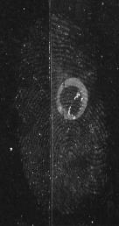
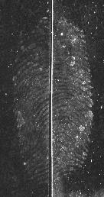
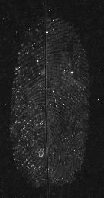
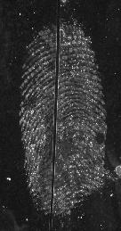
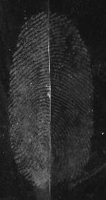
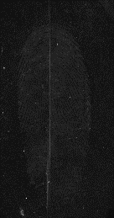
Nanoparticle concentration
Transparent polypropylene
Reduced concentration → better luminescence
  Improved interaction with fingermark
2x
4x
10x
20x
SiO₂ NPs
0.125 mg/mL
Room temperature
1 hour
H₂O
5 min
H₂O
5 – 10 min
20x
40x
80x
200x

Slide 7
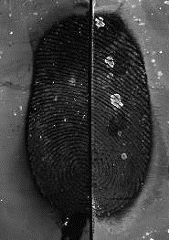
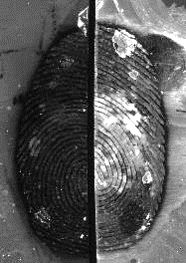
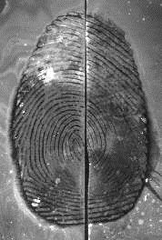
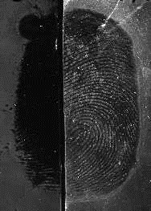

Concentration of COOH on nanoparticle surface
Surface CES interacts with itself at high concentrations
  Less available for fingermark
Improvement most dramatic for weak donor
100%
80%
100%
60%
60%
50%
100%
50%
3
Donors
3
Substrates
10d | 2m
4
Depletions
Split marks
4
Concentrations
100%
80%
60%
50%
Notes:
carboxyethylsilanetriol disodium salt
Relative to original method
Aluminium foil – average donor shown

Slide 8
Simplify reagent application

Slide 9
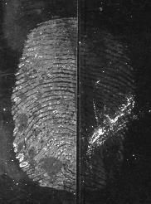
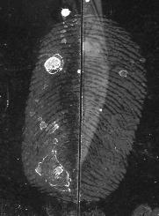
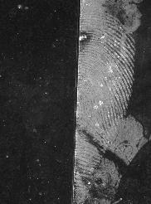
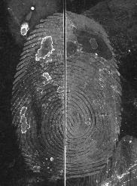
Temperature and immersion time
Strong donor
Strong donor
Weak donor
Potential interaction between fingermark and COOH
  Higher temperature should → shorter immersion time
Comparison experiments:
3, 23, 30, 35, 40, 45°C
Reduced detection time to 5 minutes
23°C
3°C
23°C
45°C
3°C
45°C
Average donor
1 hour
(23°C)
5 min
(45°C)
Moret, S., Bécue, A. & Champod, C. 2014, Nanotechnology, vol. 25, no. 42, p. 425502.
Notes:
A shaking incubator was introduced at this stage to improve consistency – even agitation and stable heating – and provide greater capacity of developing larger items.

Slide 10
Detection Parameters
SiO₂ NPs
2.5 mg/mL
Room temperature
1 hour
Published
H₂O
5 min
H₂O
5 – 10 min
SiO₂ NPs
0.125 mg/mL
35 °C – 40 °C
3 – 5 min
Modified
H₂O
5 min
H₂O
5 – 10 min

Slide 11







Optimisation study
3
Donors
3
Substrates
10d | 2m
4
Depletions
Split marks
Old | New
4
288
Fingermarks
UC comparative scale
Benchmark better
Optimised better
-2
-1
0
1
2
McLaren, C., Lennard, C. & Stoilovic, M. (2010) J. Forensic. Identif. 60 (2) 199-222

Slide 12
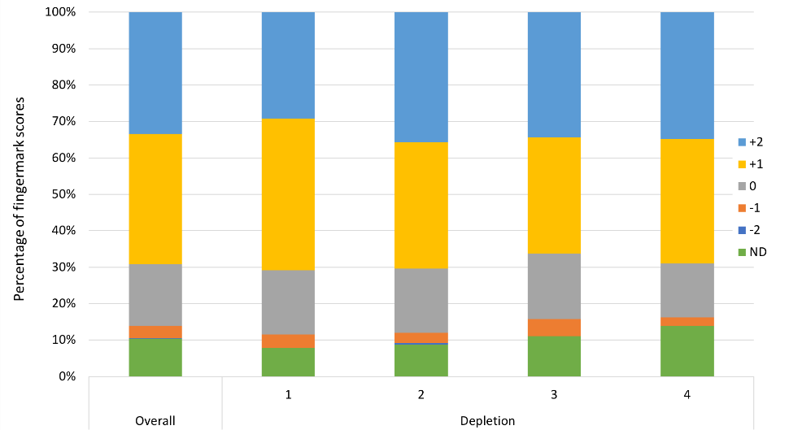
Overall Performance

Slide 13
Comparison to cyanoacrylate fuming

Slide 14
Phase 2 comparison study
6
Donors
6
Substrates
3
1, 3, 6 m
4
Depletions
Split marks
2
CAF | SiO₂
4
3456
Fingermarks
UC comparative scale
CAF better
SiO₂ better
-2
-1
0
1
2
McLaren, C., Lennard, C. & Stoilovic, M. (2010) J. Forensic. Identif. 60 (2) 199-222
Notes:
6 donors (3 males and 3 females)
6 substrates (aluminium foil, transparent PP, green PE, glass, gloss white paint, and gloss white ceramic tile)
3 age intervals (1 month, 3 months and 6 months)
4 fingers with 4 depletions
1 and 3 month marks developed so far.

Slide 15
Comparison study
Latest results - Tim
Notes:
Exposure times are still quite long – 2 s vs 20 ms
Issues with certain substrates

Slide 16
Broaden optical ‘tool kit’

Slide 17
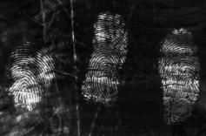
Upconverting nanoparticles
Exploit optical properties to eliminate background interference
Near IR region has greatest potential
  Normal (Stokes) luminescence
  Upconversion (Anti-Stokes) luminescence
Lanthanide upconverter nanoparticles→ theoretically promising
  Aggregation-induced quenching
  Solubility and interaction with fingermark
980 nm
550 nm
R. Ma, E. Bullock, P. Maynard, B. Reedy, R. Shimmon, C. Lennard, C. Roux, A. McDonagh, 2011, Forensic Science International, 207 pp. 145-149
R. Ma, R. Shimmon, A. McDonagh, P. Maynard, C. Lennard, & C. Roux, 2012, Forensic Science International, 217, e23-e26
Notes:
The use of SiO2 NPs doesn’t eliminate some background issues, namely interference from multicoloured, patterned or luminescent surfaces. The bulk of materials that exhibit background luminescence do so in the UV and visible regions → near IR. Background minimisation can be achieved through three main approaches: excitation in the visible and luminescence in the NIR (large Stokes shift or FRET, e.g. STaR 11). Excitation and emission in the NIR (short Stokes shift, spirulina and Egyptian blue). Excitation in the NIR and emission in the visible (upconverters).
Coating upconverters with silicon oxide is a possible solution to quenching and solubility issues. The same approach has been successful with cadmium-based quantum dots, which exhibit similar problems.

Slide 18
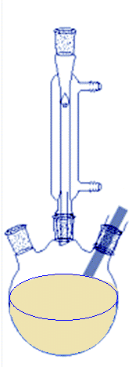
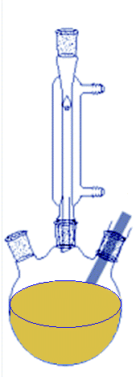


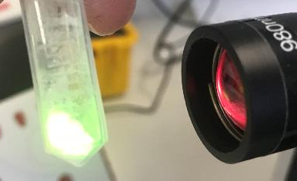
Synthesis of NaYF4:Yb,Er core
W. You, D. Tu, W. Zheng, X. Shang, X. Song, S. Zhou, Y. Liu, R. Li & X. Chen, 2018, Nanoscale, 10(24), pp. 11477-11484
NaHF₂
30 mins
310°C
180°C
Cool RT
20 mins
250°C
30 mins
YCH₃(COO)₃ + YbCH₃(COO)₃ + ErCH₃(COO)₃
+ OA + ODE
Dissolve LnCH₃(COO)₃
Decomposition of NaHF₂ to form NaF + HF
NaYF₄:Yb,Er
Notes:
NP formation very sensitive to temperature – two crystal phases are produced at different temperatures in the reaction: cubic (poor fluorescence) and hexagonal (strong luminescence). Reaching 310 degrees quickly is crucial for preparing clean hexagonal phase crystals. Fehmida now has it down to an art.

Slide 19
SiO₂ shell synthesis
Moret et al. synthesis not suitable – no shell formation
Optimisation with IGEPAL-520 in place of Triton X-100
  Reduction in luminescence
  Free-floating silicon oxide
UCNP@OA
5*UCNP -IGEPAL
Notes:
Addition of the silicon oxide shell has been more difficult. – 18 attempts to date but only getting a thin shell of silicon oxide around the nanoparticles (TEM images). Zeta potential also suggested thin silicon oxide shell.
Original SiO₂ synthesis method – Seb`s paper does not yield the shell as desired
New method using IGEPAL CO-520 was used, different method and reaction time
Increased amount of UCNP for forming the shell as analyses showed very less amount of UNCP after shell coating and free floating SiO₂
Next step is to increase the concentration of nanoparticles in the reaction solution.

Slide 20
SiO₂ shell synthesis
Moret et al. synthesis not suitable – no shell formation
Optimisation with IGEPAL-520 in place of Triton X-100
  Reduction in luminescence
  Free-floating silicon oxide
  Thin shell (~4 nm)
Lattice spacing d = 0.49 nm

Slide 21
NaYF₄:Yb,Er@SiO₂
UCNP
Cyclohexane
IGEPAL
STIR 10 MINS
IGEPAL
Ammonium hydroxide
SONICATE 20 MINS
TEOS at rate of 0.002 mL/min
SONICATE 5.75 HOURS
CES at rate of 0.002 mL/min
SONICATE 24 HOURS

Slide 22



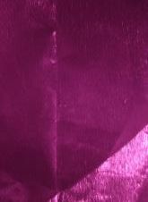
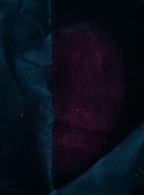
Fingermark detection with UCNP@SiO₂
1
Donor
1
Substrate
Fresh
2
Old | New
2
980 nm
Laser – manual rastering
Polilight Flare – lower intensity
NPs not strongly interacting with mark
  Improve shell formation
Flarecam
Laser
Notes:
Tried using the original working solution with 1 hour immersion time
Tried using the original working solution with 10 mins immersion time at 40°C
Rofin Flarecam and laser pointer. Ex 980 nm, em 530 nm
Decrease in luminescence of the UCNP after SiO₂ shell
Appropriate light source to image the fingermarks –
Using 980nm laser pointer (700 mW, diameter 6 mm) it has to be scanned manually over the fingermarks during imaging
Using 980 nm Flarecam (3 W, diameter 60 mm) – solves the problem of scanning the laser for imaging but the intensity of the laser is not strong per square area

Slide 23
Conclusions

Slide 24
Conclusions
Optimised reagent & application more efficient and cost effective
Silicon oxide nanoparticles less donor dependent
  Still issues with background staining on glass and ceramic
[conclusion on comparison study]
Upscaled synthesis of highly luminescent UCNPs
  Promising with improvements to silicon oxide encapsulation

Slide 25





Acknowledgments
Industry and academic partners
The fingermark donors
The CFS Fingerprint Team
Linkage Project 2017-2019

Slide 26
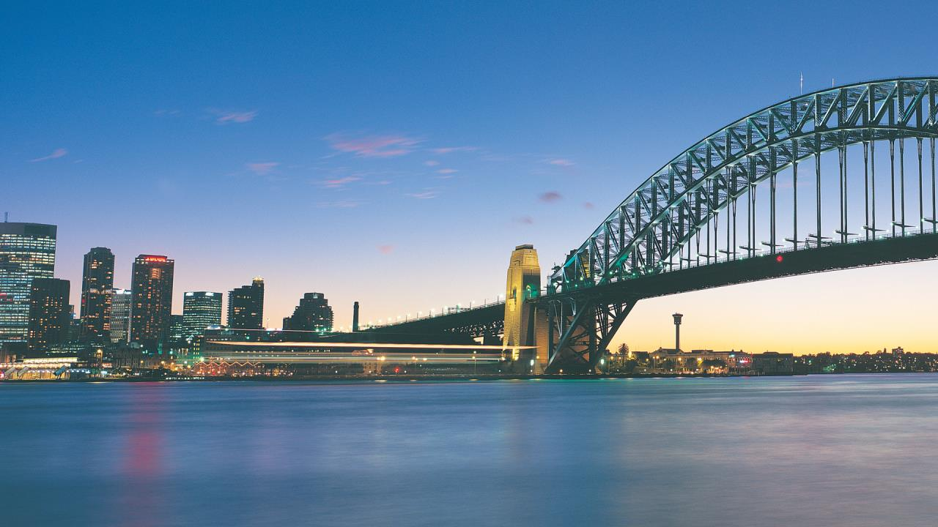

21-25 September 2020
International Convention Centre Sydney
Web: www.iafs2020.com.au
Email: iafs2020@arinex.com.au

