Slide 1
Synthesis of SiO2 NPs
Constituents of reaction | Function | Chemicals used
Amphiphile | Surfactant | Triton X-100
Aliphatic alcohol | Co-surfactant | n-Hexanol
Hydrocarbon | Oil | Cyclohexane
Water
Acid/Base | Catalyst | Ammonium hydroxide
Si-Precursor | Si source | TEOS
Photoluminescence agent | Dye | RuBpy
Capping agent | Surface functionalization | CES

Slide 2
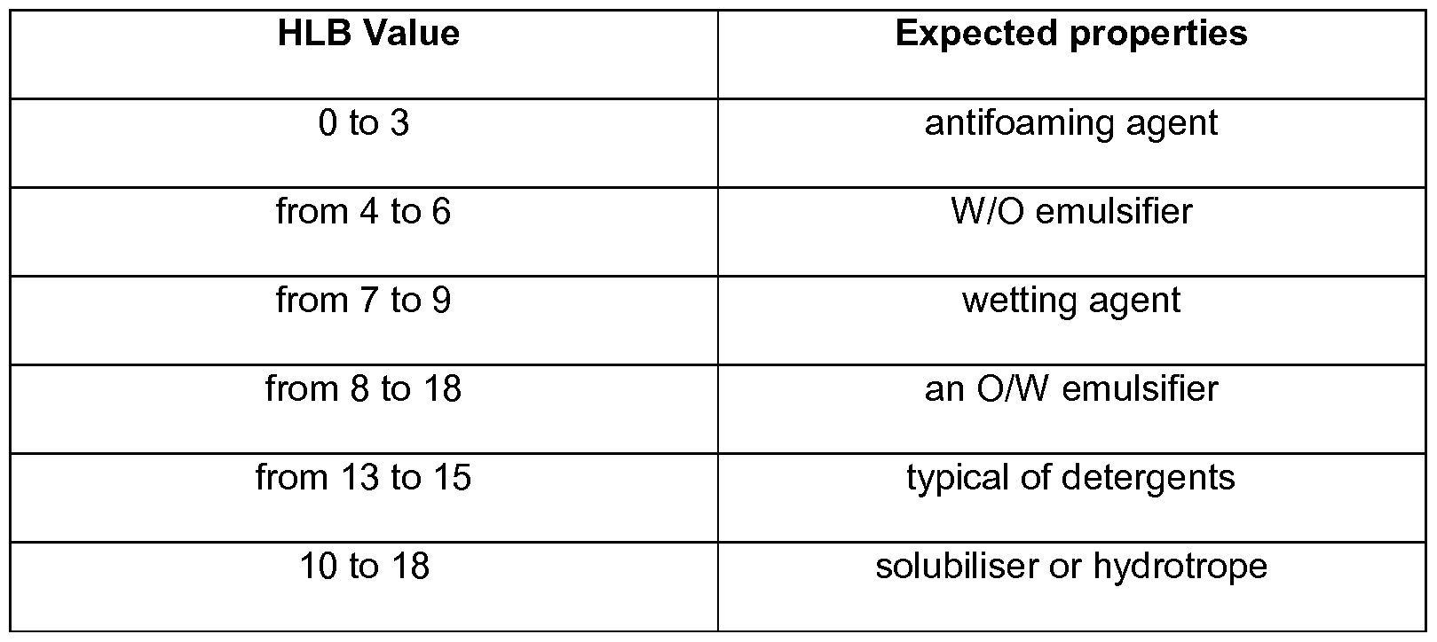
Amphiphile – Surfactant – HLB
HLB - Hydrophilic-Lipophilic Balance of a surfactant is a measure of the degree to which it is hydrophilic or lipophilic. HLB scale ranges from 0 to 20

Slide 3
HLB of Emulsifiers
Commercial Name | Chemical Name | HLB Value
Glyceryl monostearate | Glyceryl monostearate | 3.8
Span 20 | Sorbitan monolaurate | 8.6
Span 40 | Sorbitan monopalmitate | 6.7
Span 60 | Sorbitan monostearate | 4.7
Span 65 | Sorbitan tristearate | 2.1
Span 80 | Sorbitan monooleate | 4.3
Span 85 | Sorbitan trioleate | 1.8
Tween 20 | Polyoxyethylene sorbitan monolaurate | 16.7
Tween 21 | Polyoxyethylene sorbitan monolaurate | 13.3
Tween 40 | Polyoxyethylene sorbitan monopalmitate | 15.6
Tween 60 | Polyoxyethylene sorbitan monostearate | 14.9
Tween 61 | Polyoxyethylene sorbitan monostearate | 9.6
Tween 65 | Polyoxyethylene sorbitan tristearate | 10.5
Tween 80 | Polyoxyethylene sorbitan monooleate | 15.0
Tween 81 | Polyoxyethylene sorbitan monooleate | 10.0
Tween 85 | Polyoxyethylene sorbitan trioleate | 11.0

Slide 4
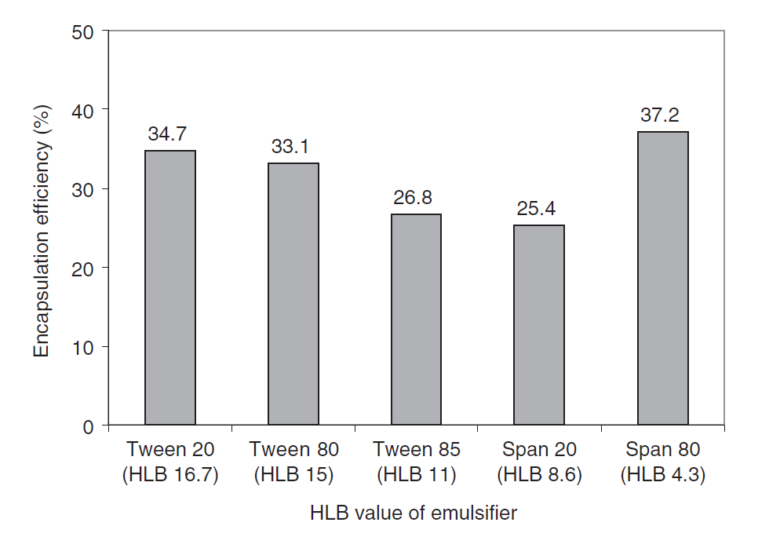
Effect of HLB of emulsifier on encapsulation efficiency
Effect of surfactant HLB and different formulation variables on the properties of poly-D,L-lactide microspheres of naltrexone prepared by double emulsion technique
R. Dinarvand, S. H. Moghadam, A. Sheikhi & F. Atyabi, Journal of Microencapsulation, March 2005; 22(2): 139–151

Slide 5
Replacing Surfactant : Triton X-100 with Tween 85
HLB of Triton X-100 : 13.5
HLB of Tween 85 : 11.0
Lower HLB beneficial for water-in-oil emulsions
Requires higher amount of surfactant but that increases solubilisation and helps in stabilizing the synthesised NPs
Triton X- 100 more harmful to environment and has estrogenic activity
Tween 85 environmentally friendly

Slide 6
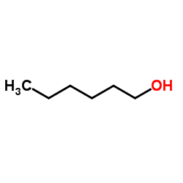
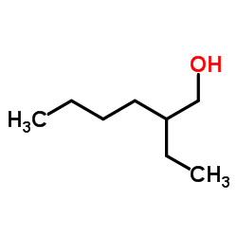
Replacing Co-surfactant : n-hexanol with 2-ethylhexanol
n-hexanol – straight chain molecule
2-ethylhexanol – branched chain – promotes formation of W/O emulsion

Slide 7
Replacing Hydrocarbon (oil) : Cyclohexane with Heptane
Heptane is more stable and netter solubilisation capacity compared to Cyclohexane

Slide 8
New Synthesis of SiO2 NPs
Constituents of reaction | Chemicals previous used | Chemicals to be replaced
Amphiphile | Triton X-100 | Tween 85 / Span 80
Aliphatic alcohol | n-Hexanol | 2-ethylhexanol
Hydrocarbon | Cyclohexane | Heptane
Water
Acid/Base | Ammonium hydroxide | Ammonium hydroxide
Si-Precursor | TEOS | TEOS
Photoluminescence agent | RuBpy | RuBpy
Capping agent | CES | CES
Improved Synthesis of Nanosized Silica in Water-in-Oil Microemulsions
Tomasz Koflecki, Izabela Polowczyk, Anna Bastrzyk, and Wojciech Sawinski, Journal of Nanoparticles, Volume 2016, Article ID 8203260

